Slide 1
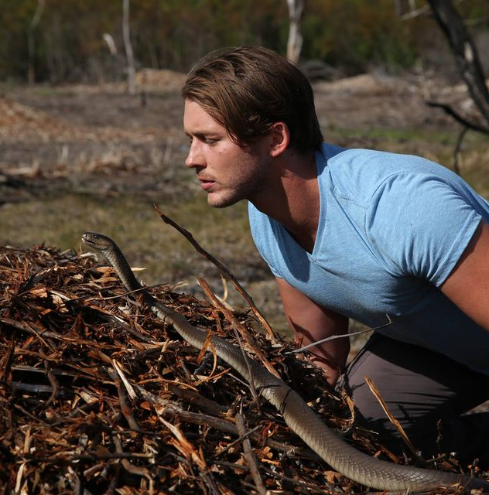
Watch Kurdt Greenwood: Keynote Talk Snippet
Watch Kurdt Greenwood: showreel
Kurdt Greenwood is a young, dynamic naturalist, conservationist, survival expert, and animal behavior specialist with a passion for wildlife that knows no bounds. From an early age, Kurdt has been captivated by the natural world, particularly the most dangerous and deadly creatures that inhabit it.
His enthusiasm for wildlife is infectious, leaving audiences both terrified and mesmerized. With his charismatic personality and profound knowledge, Kurdt has become a sought-after speaker at events worldwide, inspiring others to appreciate and conserve the natural world.
Kurdt’s influence as a speaker extends beyond his technical expertise. His passion for wildlife and conservation is evident in every presentation, inspiring audiences to take action in their own lives.
He has a natural talent for storytelling, bringing his adventures to life with vivid detail and emotional resonance. Whether he is recounting a close call with a predator or explaining the intricate behaviors of a venomous snake, Kurdt’s stories captivate and educate, leaving a lasting impact on his listeners.
He collaborates with conservation organizations, participates in research projects, and engages with local communities to promote sustainable practices.
Sample Keynote Categories:
Only Knowledge Can Abolish Fear
Kurdt Greenwood
Passionate Wildlife Conservationist & Africa’s Deadliest Animals Expert
Fee: $12,500
*Travel Buyout of $2,500 – International Travel: Business Class flights and accommodation
** Travels from Atlanta, GA

