Slide 1
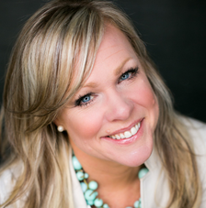
Watch Erin Hatzikostas: Ted Talk
Watch Erin Hatzikostas: Speaker Showreel
Erin Hatzikostas is an expert on the impact of authenticity in the workplace. She is the founder of b Authentic inc, where she’s leading a movement to eradicate the workplace of its BS and make it a fundamentally more authentic place.
Erin Hatzikostas holds a BBA in Statistics from Western Michigan University and an MBA in Finance and Marketing from the University of Connecticut.
Erin Hatzikostas spent her career “first half” working in the corporate world, where at the age of 42, she became the CEO of a large healthcare financial institution.
She took a struggling company and led a massive turnaround, tripling earnings and sending employee engagement skyrocketing. Her secret? Radical authenticity.
Key Takeaways:
Women often fear they’ll have to compromise to rise – compromise their family, their health, or even their soul. As a result, we don’t lean into the big girl job.
Most Popular Keynote Topics
How to Use Authenticity as Your #1 Strategic Advantage
How Strategic Authenticity can transform you culture, career and influence
The 50% Rule: A Simple Formula to Go from Unnoticed to Unmatched (in a Hot Second)
ERIN HATZIKOSTAS
AUTHENTIC LEADERSHIP
$18,500
*Client is responsible for round-trip airfare, ground transportation in event city, hotel accommodations and incidentals for up to two nights

