Slide 1
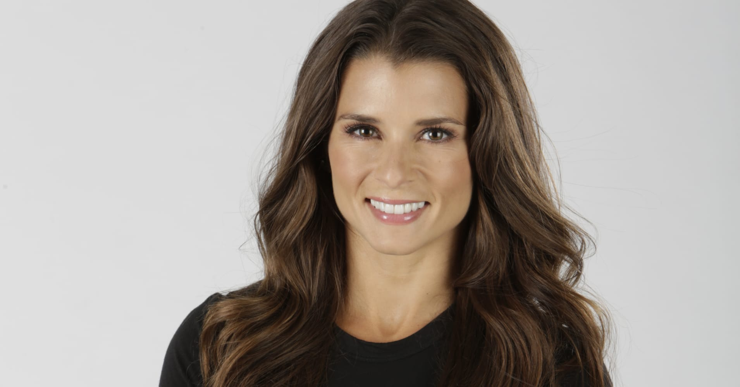
Watch Danica Patrick: Interview with GoDaddy
Watch Danica Patrick: Virtual Interview with Tamron Hall
Broke barriers and set records as a racecar drive, succeeding in the male-dominated world of motorsports
Made a name for herself after leading 19 laps and finishing in 4th place in her first Indy 500 race, becoming the first woman to lead laps and score a top 5 finish in the race
First woman to win a major league open-wheel race in a North American series with her victory in the IndyCar Series Indy Japan 300 and the first woman to win a NASCAR Cup Series pole when she set the fastest time in qualifying 500 and then finished in eighth place, the highest finishing position for a woman ever in the race
Launched the clothing line, Warrior by Danica Patrick and is host of the podcast, Pretty Intense, where she hosts deep discussions with powerful individuals about life and inspiring ideas ultimately realizing how to be your true best self
Named to TIME’s 100 Most Influential People list, has appeared in a record-setting 14 Super Bowl commercials and graced the cover of countless prestigious publications
Key Takeaways:
She shares her story of making a name for herself in a male-dominated industry motivating listeners to achieve their goals regardless of the ceilings they may have to break
DANICA PATRICK
Record-setting Racecar Driver
$90,000
*Client is responsible for $12,500 airfare buyout, ground transportation, hotel accommodations and incidentals for up to two nights
**Format: Moderated Q&A

