Slide 1
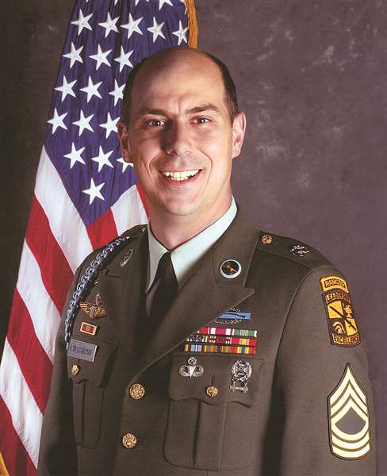
Watch Matt Eversmann: SHOWCASE VIDEOS
Former First Sergeant Matt Eversmann placed in charge of a group of Army Rangers to lead a daytime raid against an eager enemy militia in 1993, ending up trapped in a hostile district of Mogadishu and marked for death by an angry mob
Inspiring story of survival was immortalized in the epic film, Black Hawk Down
Awarded the Bronze Star Medal with Valor device for his heroic actions
Committed to sharing the lessons he learned in the military, he draws parallels from his experiences to highlight the importance of leadership, followership, courage and responsibility within any team or enterprise
Recently filmed a documentary for PBS in Afghanistan, Send Me, which highlights the tremendous advances in battlefield medicine since his days on the dusty streets of Mogadishu
Co-author of The Battle of Mogadishu and of two books with James Patterson that highlight the courage of everyday men and women, Walk in My Combat Boots and ER Nurses, both of which became immediate New York Times bestsellers
Runs a consulting company that helps companies develop successful veteran hiring programs and co-hosts a weekly podcast called The Veterans Nation
Keynote Topics:
Strategic Shock: Leadership Lessons for Business from Black Hawk Down
FUSION Leadership: How to be an Elite Leader and Manager
MATT EVERSMANN
Heroic Military Leader
Fee: $15,000
*Client is responsible for hotel accommodations and incidentals for up to two nights

