Slide 1
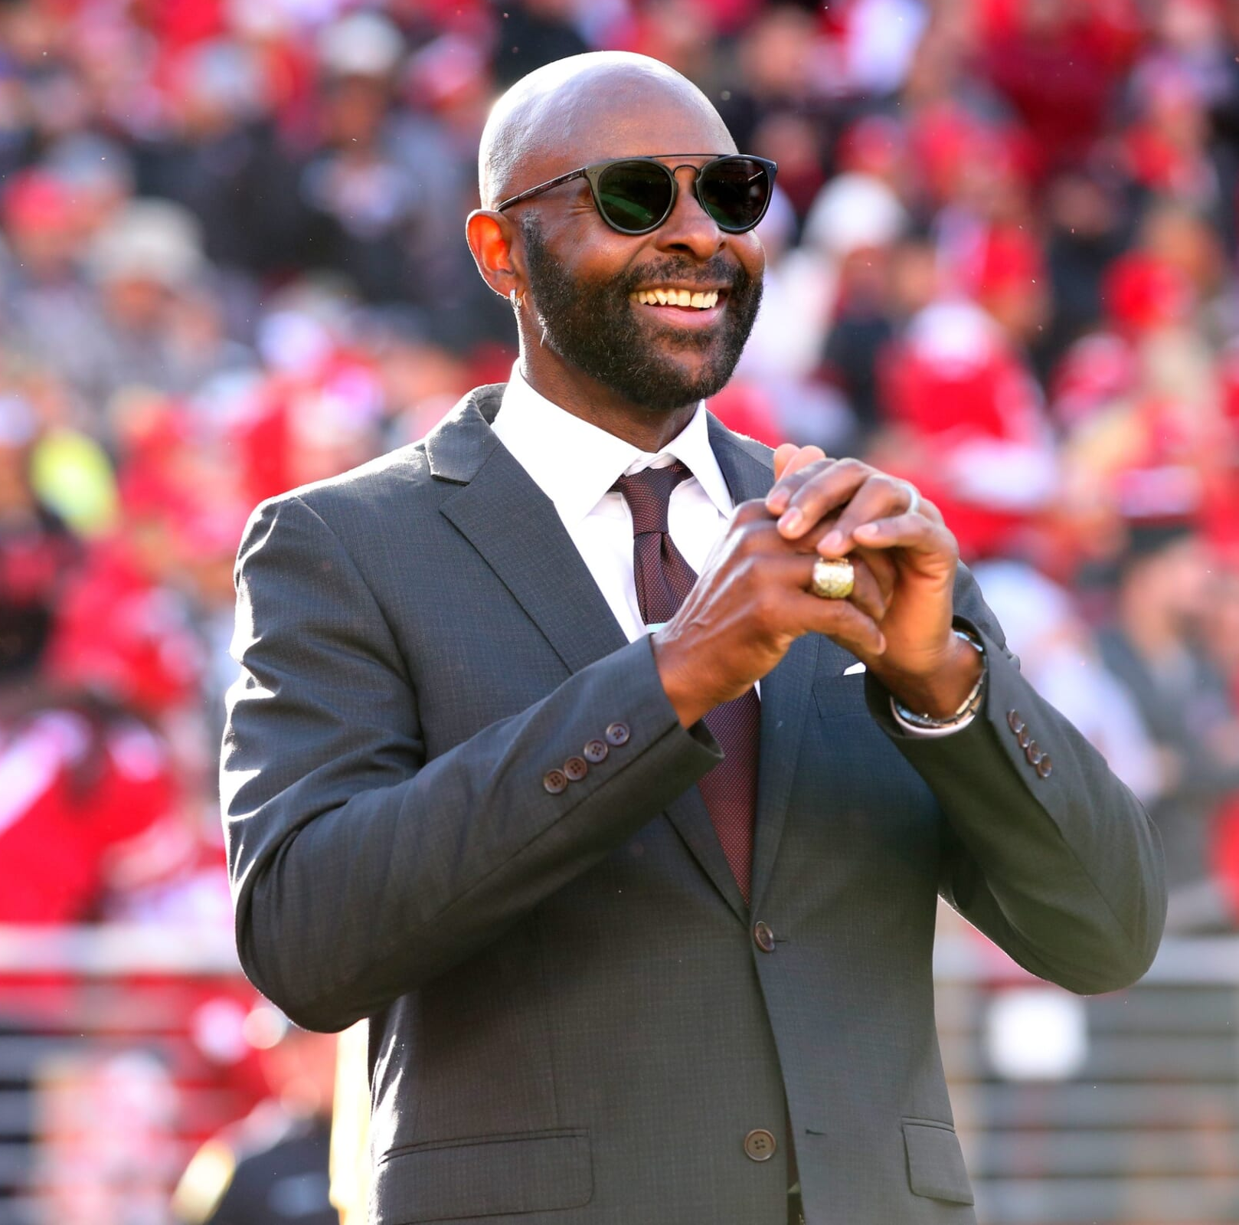
Watch Jerry Rice: Journey to Becoming an NFL Star
Known as one of the best players to ever see a football field
Wide receiver whose accolades include 3-time Super Bowl Champion, a Super Bowl MVP, a 10-time First Team All Pro, and holds NFL record for receptions, receiving yards and touchdowns, total touchdowns, and all-purpose yards
Created the Jerry Rice 127 Foundation which provides financial support to agencies and organizations in the San Francisco Bay Area and beyond dedicated to helping children and their families
Partnered with Steve Young to create the 8 to 80 Zones which provides youth living in underserved communities the skills to pursue careers in technology, esports, gaming, and media
The Jerry Rice Award, created in 2011 and named after the famed receiver, is awarded annually in the USA to the most outstanding freshman player in the Division I Football Championship of college football as chosen by a nationwide panel of media and college sports information directors
JERRY RICE
Celebrated Pro-Football Player
$36,000
*Client is responsible for round-trip airfare, ground transportation in event city, hotel accommodations and incidentals for up to two nights

