Slide 1
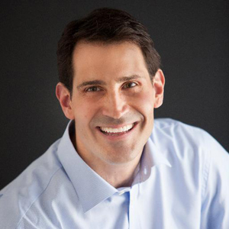
Watch Andy Papathanassiou: Over the Wall Thinking
Became NASCAR’s first pit crew coach when hired by Hendrick Motorsports in 1992, as an original member of Jeff Gordon’s Dupont #24 race team
Recognized as the person whose philosophy and views as an outsider to NASCAR ultimately shifted the paradigm of how pit crews recruit, select and develop team members with his Over The Wall thinking method
Boasts a 30-year racing career, with over 250 wins and 16 series championships
Serves as Director of Human Performance with Hendrick Motorsports
Held the position of Executive Director of the North Carolina Motorsports Association (NCMA) from 2006-2012, an organization for which he now sits on the board of directors
Keynote Topics:
Over The Wall Thinking
ANDY PAPATHANASSIOU NASCAR Pit Crew Coach
Fee: $17,500
*Travels from Charlotte, NC

