Slide 1
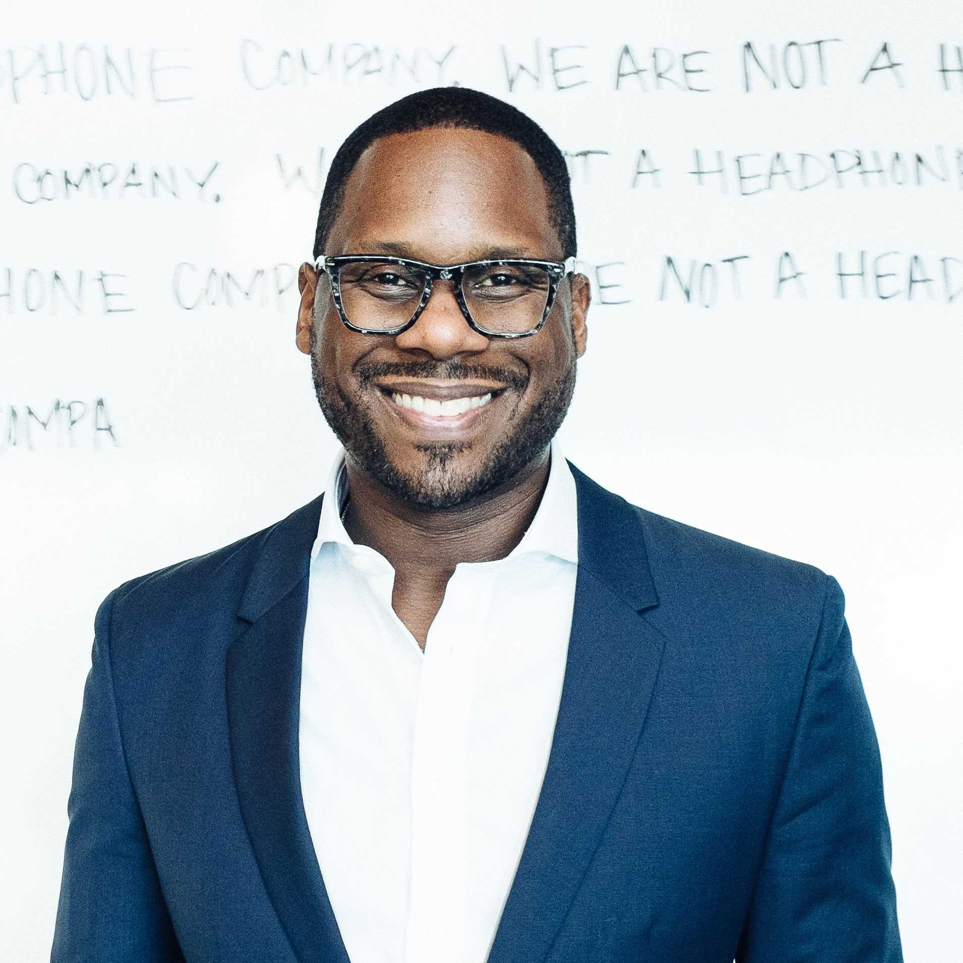
Watch Omar Johnson: Sizzle Reel
Watch Omar Johnson: Interview with CEO Interviews
Omar Johnson is recognized as a marketing innovator in the art of building world-class brands
Former CMO of Beats by Dre and VP of Marketing at Apple who has led all facets of marketing, ranging from brand development and positioning to advertising and global digital marketing and is credited for making a connection between music and sports leading to some of the most impressive growth and marketing strategies in business today
Under his reign, Beats grew from $20 million to a $2 billion dollar category leader, becoming the #1 premium headphone in over 25 countries, which led to the subsequent purchase by Apple for $3 billion
Named by Adweek as a “Brand Genius,” and by Business Insider as one of the “Most Innovative CMOs”
Founded ØPUS United, a modern brand management company comprised of a multi-disciplined collective of award-winning executives, athletes, strategists, creatives, and musicians, who understand the anatomy of world-class brands
Through his work with ØPUS United, he has also been actively involved in developing initiatives, such as We The People and We Got Next, and authored Dear White Corporate America to encourage conversations around racial equity and the empowerment of younger generations to take action through polling, voting, and representation within the government
Sample Keynote Topics:
Leading Through AI: Navigating the New Frontier
B2H: BUSINESS TO HUMAN MARKETING
LEADERSHIP: MEETING PEOPLE WHERE THEY ARE
THE BEATS STORY: BUILDING A WINNING COMPANY CULTURE
BUILDING TECH COMPANIES FROM THE GROUND UP AND HARNESSING AI
OMAR JOHNSON
Leading Voice in Marketing & Branding
$55,000
*Client is responsible for a $5,000 travel buyout
**Speaker to book and pay for all travel including airfare, home and event city ground transportation, hotel, meals and incidentals.
***For privacy reasons, Speaker will not stay at venue hotels

