Slide 1
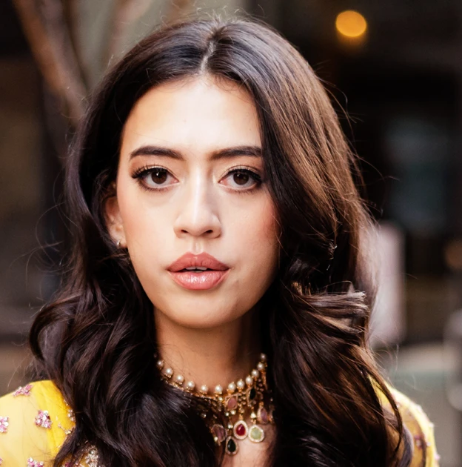
Watch Lily Brasch: Showreel
Born with a rare congenital condition and was predicted to never walk, Lily Brasch has defied all odds to inspire audiences worldwide with her incredible journey of overcoming adversity and pursuing greatness.
Lily has trained to climb mountains and compete in National Muscle Building competitions.
Her speeches touch on themes of perseverance, adaptability, and achieving the impossible, resonating deeply with audiences across industries.
Lily’s electrifying presence and impactful messages make her a sought-after voice in corporate conferences, leadership summits, and motivational events.
Lily Brasch is more than a speaker—she’s a transformational force who leaves a lasting impact on every audience she engages with. Event planners seeking a keynote speaker who combines personal authenticity with a universal message of hope and determination will find Lily to be the perfect choice.
Her story of overcoming adversity captivates and motivates audiences of all backgrounds. Whether she is addressing corporate teams, educational institutions, or large conferences, Lily brings unmatched energy and a unique perspective that resonates deeply.
She doesn’t just tell her story; she invites audiences to see themselves in her journey, leaving them inspired to tackle their own challenges head-on.
Speech Availability:
Lily will speak for 15 minutes standing up and then take Q&A sitting down
If stage allows her to sit and giver her speech it can be then 30-minute talk plus Q&A
Available for moderated discussions and Fireside chats
LILY BRASCH Inspirational Speaker
Fee: $12,500
*Travels from: New York City.
**Client to pay for 2 x travel and all ground, accommodation and incidental costs

