Slide 1
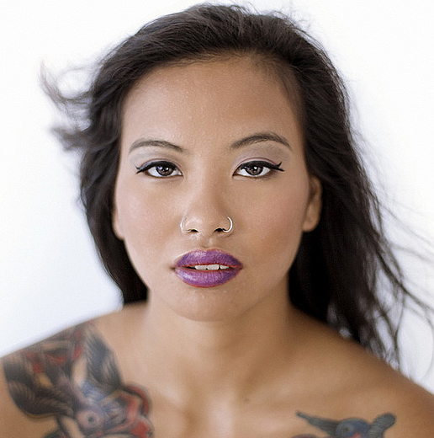
Watch Kanya Sesser: Whatever it takes
Kanya Sesser is an internationally recognized para-athlete, groundbreaking model, actress, and motivational speaker whose life epitomizes resilience and determination.
Born without legs and abandoned as a baby in Thailand, Kanya overcame immense challenges to become a global symbol of empowerment. Her motto, “No legs, no limits,” captures her journey of defying expectations and inspiring others to break barriers.
With a career spanning adaptive sports, fashion, entertainment, and public speaking, Kanya’s multifaceted talents and powerful message make her a sought-after keynote speaker for events worldwide.
Her story of perseverance, courage, and advocacy for inclusivity resonates with audiences across industries and cultures.
Kanya’s dynamic talks inspire audiences to overcome adversity, embrace their uniqueness, and pursue their dreams with unwavering determination. Her ability to combine these experiences into a cohesive and impactful message sets her apart as an expert in resilience and inclusivity.
Kanya’s story of overcoming adversity resonates with audiences, motivating them to break through their own limitations.
Her unique perspective as a para-athlete and model brings critical insights into inclusivity and representation, fostering important conversations for organizations and communities.
Her powerful story, coupled with her dynamic presence, makes her an exceptional choice for events seeking a speaker who delivers authenticity and impact.
Keynote Topic
"No Legs, No Limits: Redefining Possibility and Embracing Resilience"
Kanya Sesser
Paralympian, Model &
Inspirational Speaker
$18,500
*Client is responsible for ground transportation in event city, hotel accommodations and incidentals for up to two nights
** Travel Buyout of $2,000
Travels from Los Angeles, CA

