Slide 1
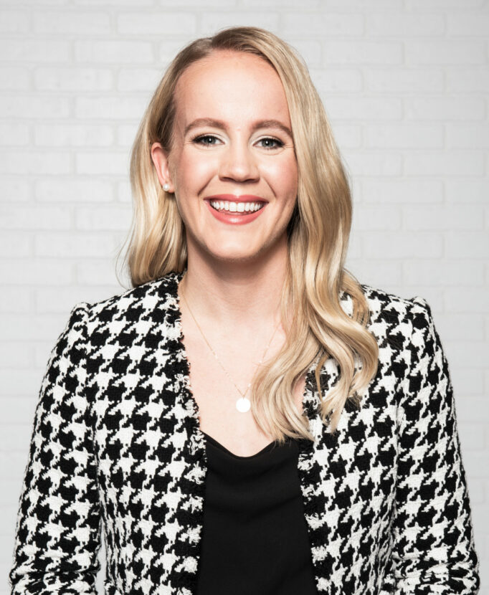
Watch Mallory Weggemann: TED - Triumph Over Tragedy
Watch Mallory Weggemann: Discussing Her Memoir
Competitive swimmer, 3-time Paralympian and 5-time Paralympic Medalist
Won 2 gold medals and 1 silver medal at the 2020 Tokyo Paralympic Games
Set 15 world records and 33 American records within 4 years of suffering an injury that led to permanent paralysis
After suffering a second injury that could have left her sidelined, Mallory persevered to make the 2016 Rio Paralympic Games
“
Author of Limitless: The Power of Hope and Resilience to Overcome Circumstance”
Sample Keynote Topics:
Small Steps, Big Impact: A “Small Victories” Approach to Leadership
Personal Stories: Finding the “Why?”
Grit, Resilience and Triumph Over Any Obstacle
MALLORY WEGGEMANN World Champion Swimmer,
Paralympic Gold-Medalist
$21,000
*Client is responsible for ground transportation, hotel accommodations and incidentals for up to two nights for two people

