Slide 1
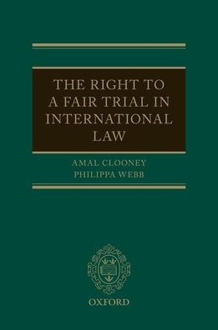
Watch Amal Clooney: Global Conference for Media Freedom
Watch Amal Clooney: Global Fight for Human Rights
Ranked in the leading legal directories Chambers and Partners and Legal 500 as one of the top lawyers in the UK in the fields of international human rights and international criminal law frequently representing victims of mass atrocities, including genocide and sexual violence, and she has acted in many landmark human rights cases in recent years
Recognized for her harrowing work as an attorney in many notable cases including her workd with Maria Ressa, a leading journalist in the Philippines, who faces over 100 years in prison based on spurious charges and was the 2021 winner of the Nobel Peace Prize
Has appeared before the International Court of Justice, the International Criminal Court, the European Court of Human Rights, and various courts in the United Kingdom and the United State
Adjunct Professor at Columbia Law School, where she teaches Human Rights.
Co-author of a book titled The Right to a Fair Trial in International Law, and the recent release, Freedom of Speech in International Law
Established the Clooney Foundation for Justice, alongside her husband in 2016, to advance justice through accountability for human rights abuses around the world
Key Takeaways:
Details her important work in human rights, her cases and the impacts the outcomes have on society and educates audiences on creating a more equal and just future for our youth
AMAL CLOONEY
Human Rights Attorney
Fee Pending
*Client is responsible for round-trip private airfare, ground transportation in event city, hotel accommodations and incidentals for up to two nights

