Slide 1
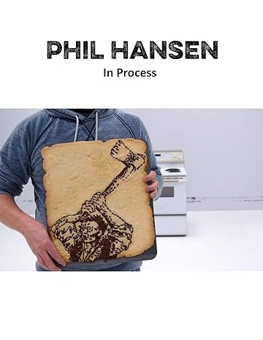
Watch Phil Hansen: Embrace the Shake
Watch Phil Hansen: Keynote Speaker Reel
Referred to by his fans as “the Artist for the People”, he is an internationally recognized multimedia artist, speaker, author and innovator at the forefront of bringing art to a wider audience
Most widely known for his meta-art, videos that document the creation process (sometimes even through destruction), showing millions, that art is action, not just result
Work also extends deeply into traditional media with features on the Discovery Channel, Good Morning America, the Rachael Ray Show, Last Call with Carson Daly, Glamour and many more
Artistic journey nearly came to an end when a tremor developed in his drawing hand, leading him to explore new ways to create art and discover that by embracing his shake, limitations could become the passageway to creativity
Keynote Topics:
EMBRACE THE SHAKE: Transforming Limitations into Opportunities
EMBRACE THE SHAKE (Virtual Program)
Key Takeaways:
Helps audiences identify preconceived assumptions that cause us to believe obstacles have the power to limit success and encourage managing change through application of systemic creativity
Shares insights on how to reduce stress by turning inwards and looking at how our internal resources can solve the challenges ahead
PHIL HANSEN
Creativity & Innovation Speaker
$25,000
* $1,500 flat travel fee, plus client is responsible for venue-city ground and hotel

