Slide 1
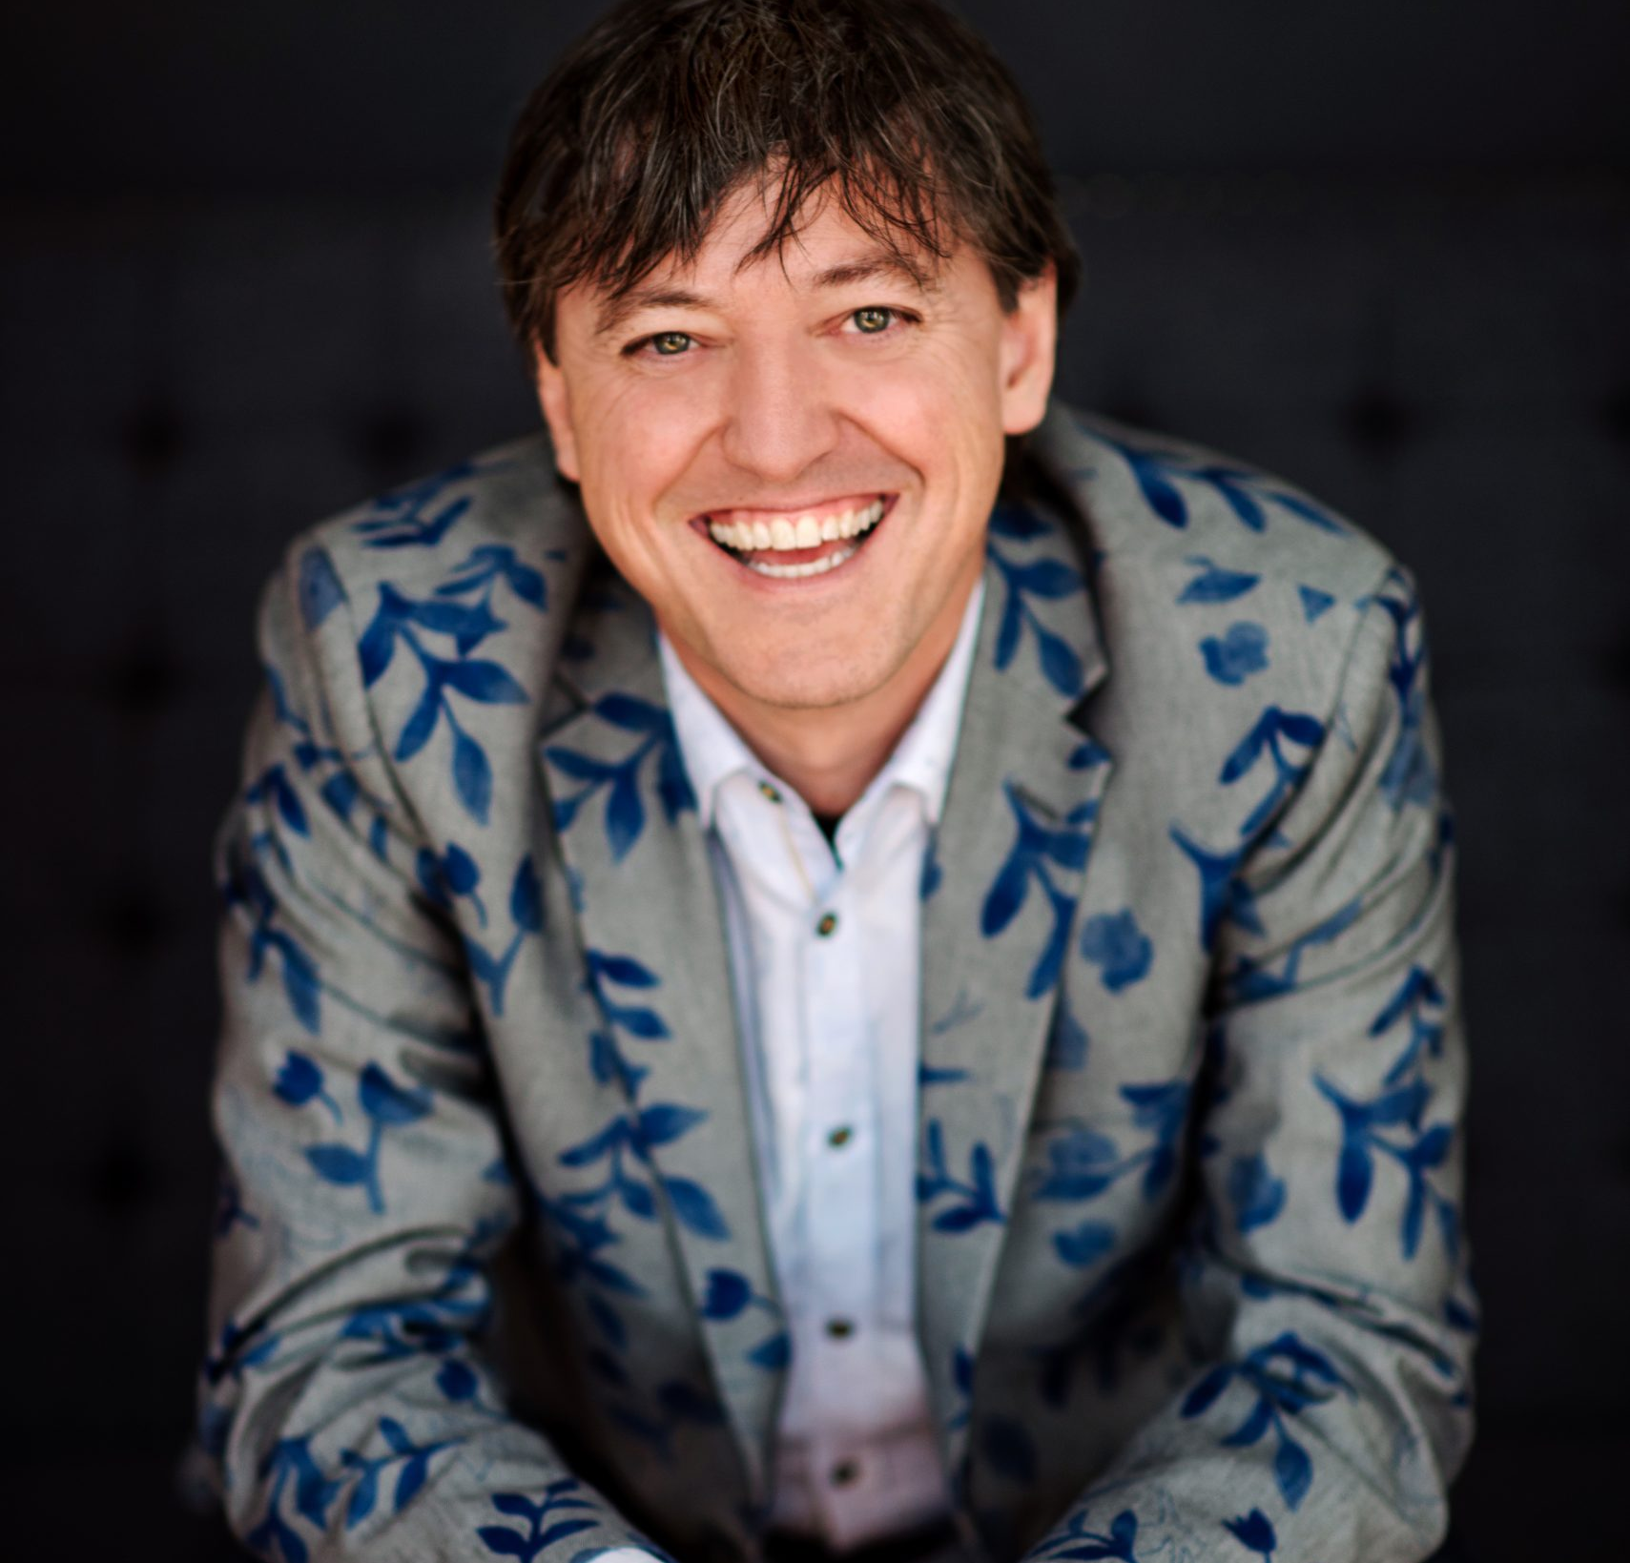
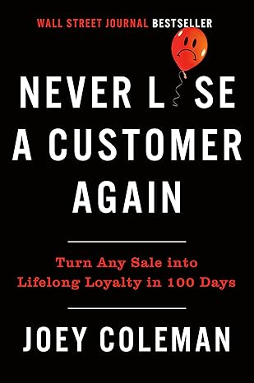
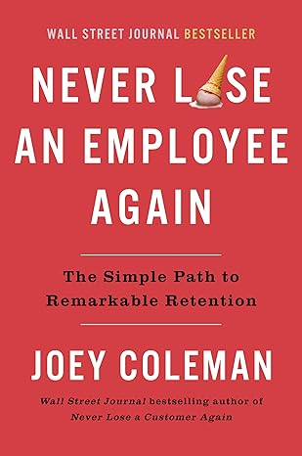
Watch Joey Coleman: Why the First 100 Days are Critical for New Customers
Work focuses on helping organizations retain their best customers and turn them into raving fans through
Created the First 100 Days methodology which helps to fuel the success of customer experiences
Author of Never Lose a Customer Again, a Wall Street Journal #2 bestseller in which he shares strategies and tactics for turning one-time purchasers into lifelong customers while increasing profits along the way
Recognized as an award-winning speaker for national and international conferences delivering unique, attention-grabbing experiences, his client list includes Whirpool, NASA, the World Bank, Zappos among many others
Founder and Chief Experience Composer of Design Symphony, a customer experience branding firm that assists corporations, non-profits, small businesses, and associations in creating breathtaking interactions for their customers and constituents
Key Takeaways:
Understand the 100 Days theory, why it works and how to implement it into your organization
Identify holes in or a non-existent customer service strategy and gain actionable take aways that help all employees contribute to the customer experience
Keynote Topics:
Never Lose a Customer Again
Change the F.A.C.E.S of the Customer
Never Lose an Employee Again
JOEY COLEMAN
Customer Retention Expert
Fee: $30,000
*Client is responsible for $2,000 travel buyout, hotel accommodations and incidentals for up to two nights

