Slide 1
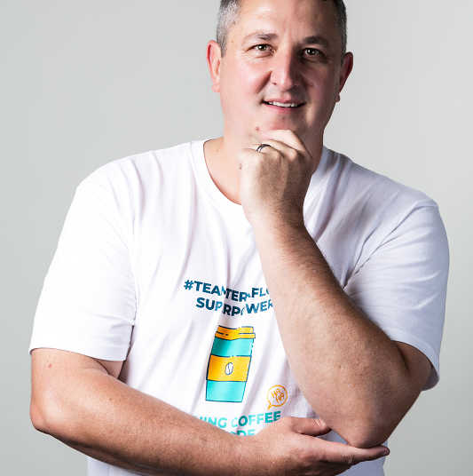
Watch Brett StClair: Speaker Showreel
Watch Brett StClair: Democratization of Compute
Brett StClair stands at the forefront of digital innovation and artificial intelligence, boasting a career that bridges the gap between cutting-edge technology and strategic business transformation.
With a rich history as an Ex-Googler, Brett has seamlessly transitioned into the world of digital banking and now serves as the CEO of Teraflow.ai, a company that is revolutionizing AI-driven solutions.
Renowned Digital Transformation Expert: Brett St Clair is a globally recognized expert in digital transformation and technology, known for his innovative approach to leveraging digital tools to drive business success.
Sought-After Speaker: Brett is a highly sought-after speaker who has captivated audiences at numerous conferences and events with his deep insights into the digital world and practical advice on navigating the technological landscape.
Transformational Insights: His presentations provide audiences with transformational insights into how technology can be leveraged to drive business growth, innovation, and competitive advantage.
Key Takeaways:
Brett’s journey from Google to digital banking and now to Teraflow.ai showcases his adaptability and forward-thinking approach, making him an influential figure in the tech world.
Keynote Topics:
Embrace the AI Revolution
Fueling the Innovation Engine
From Google to Global Banking
AI Ignition
Brett StClair
AI Technology Speaker
Fee: $12,500
*Travel buyout of $1,500 flat travel buyout (inclusive of airfare and professional home ground transportation); plus, professional event city ground transportation and hotel.
**Brett travels from New York or London.

