Slide 1
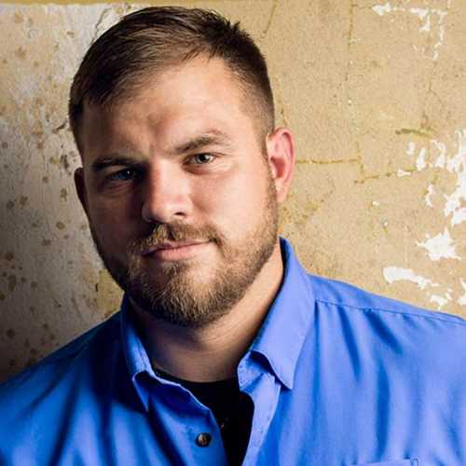
Watch Travis Mills: Never Quit
Retired United States Army Staff Sergeant of the 82nd Airborne is a recalibrated warrior, motivational speaker, actor, author and an advocate for veterans and amputees
Author of his New York Times bestselling memoir, Tough as They Come
Critically injured on his 3rd tour of duty in Afghanistan by an IED while on patrol, losing portions of both of his legs and both of his arms making him one of only five quadruple amputees from the wars in Iraq and Afghanistan to survive his injuries
Tells his story of overcoming life’s challenges, breaking physical barriers and defying odds, described as the epitome of resilience, leaving an indelible mark on audiences
Subject of the Netflix original movie “Travis – A Soldier’s Story and has been featured on The Ellen Show, NBC, CBS, Fox News, CNN among other outlets
Founded the Travis Mills Foundation, a non-profit organization which supports recalibrated veterans and their families through various programs that help heroic men and women overcome physical and emotional obstacles, strengthen their families and provides well-deserved rest and relaxation
Keynote Categories:
Tough As They Come
Mental, Physical and Emotional Toughness
Never Give Up, Never Quit
TRAVIS MILLS
Retired U.S. Army Staff Sergeant
Fee: $40,000
*Client is responsible $3,500 travel buyout, excludes hotel

