Slide 1
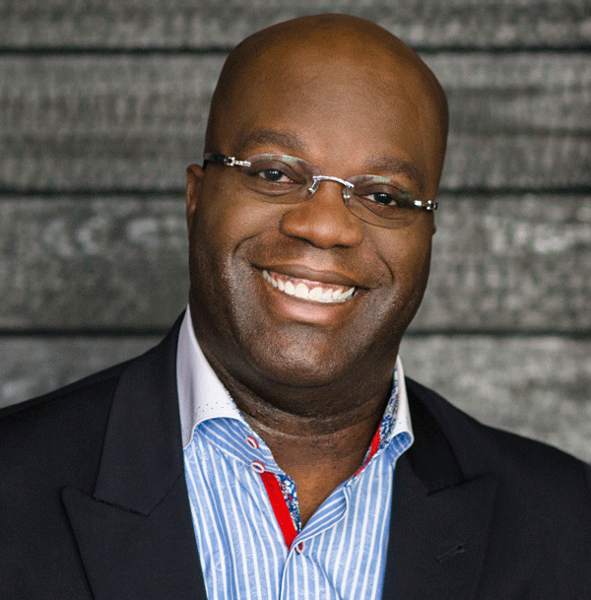
Watch Simon Bailey: Shift Your Brilliance: Act Like an Employee, Think Like a CEO
Watch Simon Bailey: To Break Through, Find Your True Calling
Award-winning motivational speaker who delivers an inspirational message of hope, success and self-actualization with insatiable passion and believes that every single person is brilliant and that you are meant to share your brilliance
Understands the pressure leaders and high performers are facing in the midst of uncertainty and equips them with simple, easy-to-implement strategies to accelerate results and ignite sustainable transformation
Created online courses for empowerment in leadership, 3 of which are featured on LInkedIn Learning and reach professionals in over 100 countries
Has more than 30 years of experience in the hospitality industry, including serving as sales director for Disney Institute, and has worked with more than 1,800 organizations in 50 countries
Named one of the top 25 people who will help you reach your business and life goals by SUCCESS magazine, recognized as one of the 12 business speakers who embolden audiences to think big and lead with purpose and as one of the top sales kickoff speakers
Author of 7 books, all of which offering inspiring guidance and actionable takeaways to believe in your own brilliance
Keynote Topics:
Spark Empathetic Leadership with Accountability
Release Your Brilliance – Forget Your Title and Transform Your Job
Shift Your Brilliance – Act Like an Employee and Think a CEO (Creative Engagement Optimist)
SIMON T. BAILEY
Leading Voice in Motivational Leadership
$40,000
*Client is responsible for round-trip airfare, ground transportation in event city, hotel accommodations and incidentals for up to two nights

