Slide 1
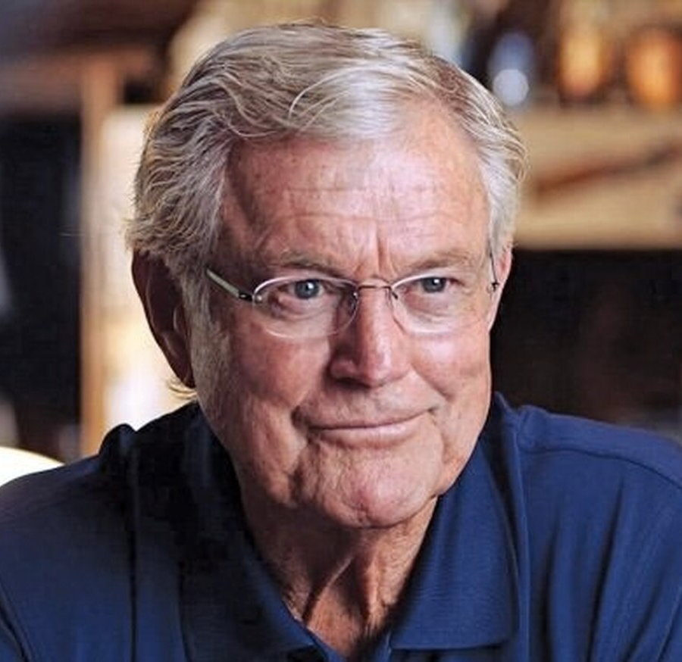
Watch Dick Vermeil: NFL Pro Football Hall of Fame Speech
Watch Dick Vermeil: Interview with The Rick Eisen Show
Heralded for one of the most distinguished coaching careers in NFL history, his illustrious career includes a 15-year tenure as an NFL coach
Coached the Philadelphia Eagles to Super Bowl 15, a team which previously spend two decades without a playoff appearance, led the St. Louis Rams to victory in Super Bowl 34 and coached the Kansas City Chiefs, taking the team to the playoffs in his 3rd season with the team
Broadcasting career spanned 14 years, serving as an NFL and college analyst for CBS and ABC
One of four coaches in NFL history to lead two different teams to the Super Bowl and one of five coaches to lead three different teams to the playoffs
Portrayed by Greg Kinnear in Invincible and Dennis Quaid in The American Underdog
Named NFL Coach of the Year twice and is an NFL Hall of Fame Coach in the class of 2022
Key Takeaways:
Offers motivational takeaways about teamwork, overcoming setbacks, and unpacks what it takes to lead a team or organization through obstacles to unparalleled success
Sample Keynote Topics:
Fireside Chat with Dick Vermeil
Leadership: Coaching Your Team to Success
DICK VERMEIL
Distinguished NFL Coach, Analyst,
Subject of 2 Major Motion Pictures
$45,000
*Client is responsible for round-trip airfare, ground transportation in event city, hotel accommodations and incidentals for up to two nights

