Slide 1
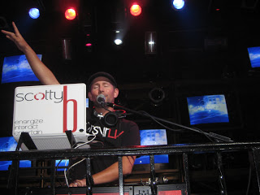
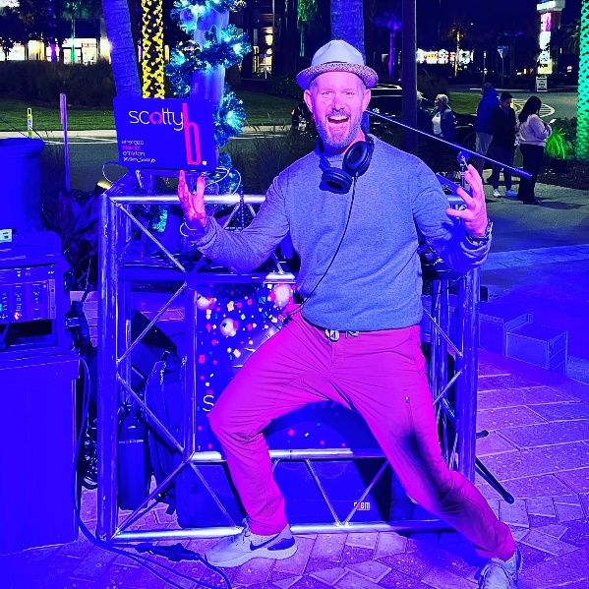
DJ SCOTTY B
Scott A. Bragg (Scotty B) has been performing in the Orlando area for over 20 years. He began his career as a freestyle hip-hop dancer & professional DJ. His dynamic personality and comedic disposition led him to the world of crowd interactive entertainment.
During his time with Universal, he was the lead for the WNBA's Orlando Miracle interactive dance squad, a position he held for two years before transforming himself into the first "In-Game" host for the WNBA’s Orlando Miracle (Now the Connecticut Sun) home games.
Currently, Scott holds residency as a Host/DJ for ‘Blue Martini’ in Orlando and is the driving force of music behind “Project: DJ Slam!” - an interactive DJ/Drummer showcase utilizing live musicians in the mix!
Watch Live Show Reel
Fee: On Request
(DJ & Emcee - based on 4 hours)
Client to provide: free parking, 12’ x 12’ stage, 2/20 amp quad boxes of electrical power to stage, dressing room with unlimited beverages and hot meal after sound check or $30 buyout for DJ.

Slide 2
Watch Live Show Reel
Scott A. Bragg (Scotty B) has been performing in the Orlando area for over 20 years. He began his career as a freestyle hip-hop dancer & professional DJ. His dynamic personality and comedic disposition led him to the world of crowd interactive entertainment.
During his time with Universal, he was the lead for the WNBA's Orlando Miracle interactive dance squad, a position he held for two years before transforming himself into the first "In-Game" host for the WNBA’s Orlando Miracle (Now the Connecticut Sun) home games.
Currently, Scott holds residency as a Host/DJ for ‘Blue Martini’ in Orlando and is the driving force of music behind “Project: DJ Slam!” - an interactive DJ/Drummer showcase utilizing live musicians in the mix!
DJ SCOTTY
Fee Pending
Client is responsible for round-trip airfare, ground transportation in event city and hotel accommodations for up to (2) nights
Client to provide: 12’ x 12’ stage, 2/20 amp quad boxes of electrical power to stage, dressing room with unlimited beverages and hot meal after sound check or $30 buyout for DJ.

