Slide 1
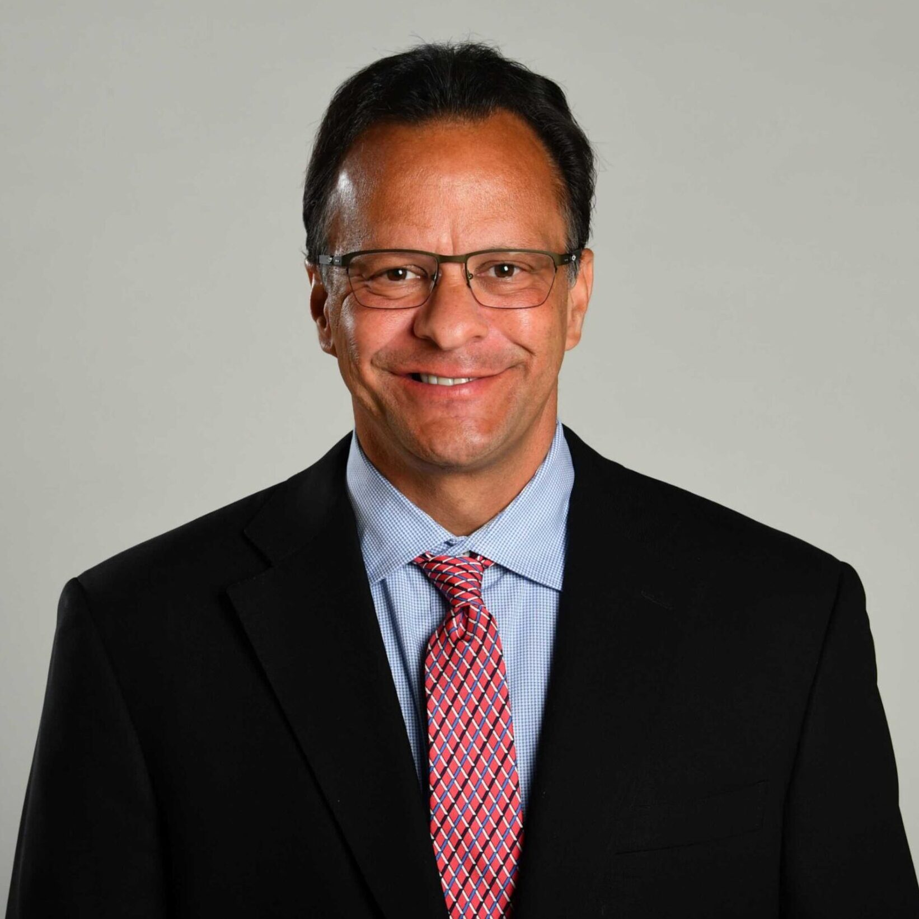
Watch Tom Crean: Video Reel
Watch Tom’s Induction Speech: Hall of Fame
ESPN college basketball analyst Tom Crean spent 22 seasons as the head men’s basketball coach at Marquette University, Indiana University, and the University of Georgia.
He is recognized for his offensive-minded concepts, winning methods of rebuilding teams and has received countless accolades leading teams to 9 NCAA appearances, 4 Sweet Sixteen’s and a Final Four. ability to rebuild teams.
Accolades include leading Marquette to the 2003 NCAA Final Four, multiple coach of the year award honors, and regularly leading his teams to national rankings and postseason bids.
Named National Coach of the Year in 2012 by ESPN and voted Big Ten Coach of the Year in 2016, the same season he was a finalist for Naismith National Coach of the Year honors
Guidance of the Indiana program to success from unthinkable depths was regarded as one of the most remarkable rebuilding projects in NCAA basketball history
Key Takeaways:
Shares strategies and insights for building winning teams from the ground up, tells stories from his decades long coaching career illustrating how to pivot to overcome challenge and methods for claiming and sustaining success
Keynote Topics:
Leadership
Overcome Adversity
Motivation
Tom Crean
Basketball Coach & Analyst
Fee: From $35,000++
*$3,000 travel buyout, excludes accommodation if required.
**Travels from Bloomington, IN

