Slide 1
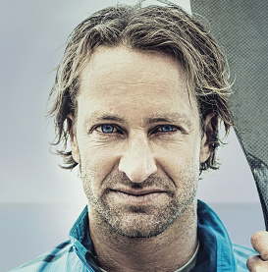
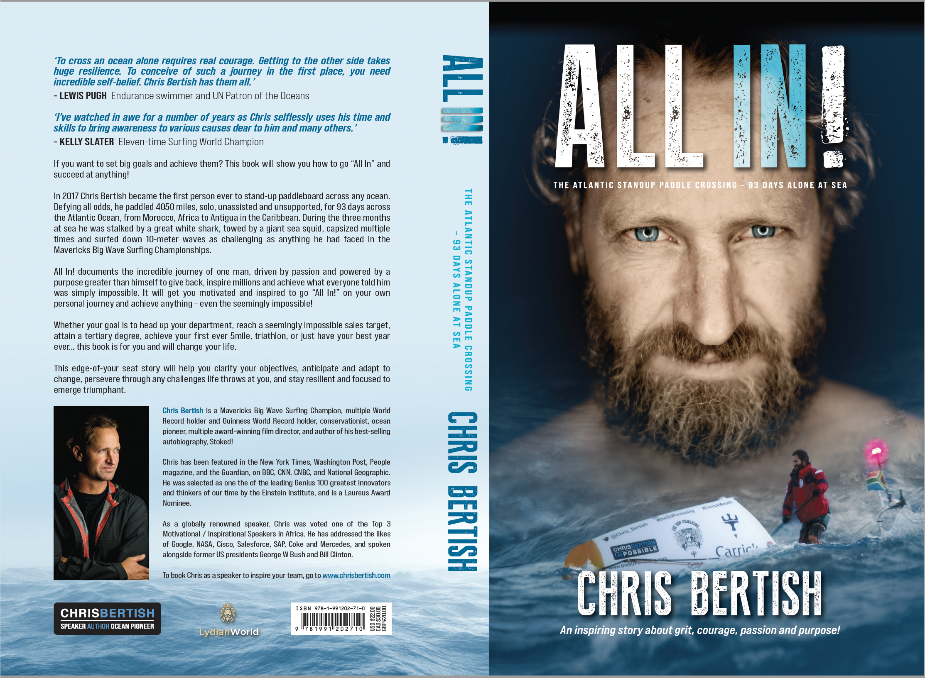
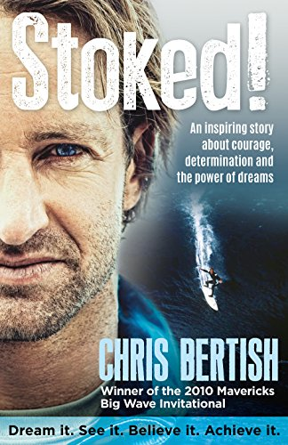
Watch Chris Bertish: All In Showreel
Watch Chris Bertish: Achieving The Impossible
1st Adventurer to cross the Atlantic Ocean on a Paddle Board Craft - UNASSISTED
1st Adventurer to cross from California to Hawaii (Pacific Ocean) using only a Wing Foil – UNASSISTED
Winner of Mavericks Big Wave Surfing Competition
Engaging Chris to address your organization is a worthwhile investment, as your team members will be inspired to adopt a “can do” attitude and implement the tools and skills he teaches through his powerful storytelling.
Chris is living proof that if you truly believe in something, set your sights on your goal – no matter how big – if you work hard at it, stay focused and never give up, you can achieve anything.
Key Takeaways:
His mantra – Dream It. See it. Believe It. Achieve It – has led Chris to redefine his approach to success – not only across multiple sports, but also as a respected Author, Filmmaker and Businessman.
Sample Keynote Topics:
Thrive! Surviving & Thriving in Turbulent Times
All In!
Achieving the Impossible! The Mavericks Big Wave Story
CHRIS BERTISH
Ocean Advocate, Adventurer, Author
$15,000
*Client is responsible for round-trip airfare, ground transportation in event city, hotel accommodations and incidentals for up to two nights

