Slide 1
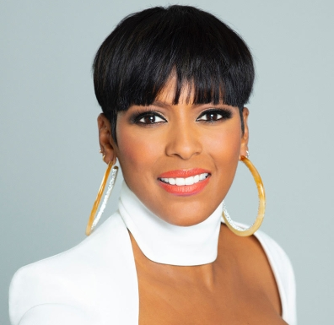


Watch Tamron Hall: Fast Company Profile
Watch Tamron Hall: Success, Satisfaction and Beauty
Journalistic excellence has earned her numerous accolades, including two Daytime Emmy Awards for Outstanding Informative Talk Show Host and two prestigious Gracie Awards from the Alliance for Women in Media Foundation
In 2014 she made history as the first African American female co-host of NBC’s TODAY and is currently the executive producer and host of nationally syndicated The Tamron Hall Show
After experiencing a personal loss to domestic violence, she has become an impactful advocate and supporter of Safe Horizon, a national organization that offers a variety of programs to support survivors of abuse
Debut novel, As the Wicked Watch, was published October 26, 2021, becoming an instant Editor’s Pick on Amazon and is first book in her critically acclaimed “Jordan Manning” mystery series
Key Takeaways:
As a transformational voice that drives change, she shares her compelling story which exemplifies triumph over adversity, unwavering resilience, and an unyielding commitment to empowering others and is a testament to the indomitable human spirit, inspiring dreamers to keep dreaming
Sample Keynote Topics:
Fireside Chat with Tamron Hall
A Journey of Triumph Over Adversity
The Motto – Bet On Yourself
TAMRON HALL
Award-winning Journalist, Host, Inspirational Storyteller, Author
Fee: 75,000 +
*Client is responsible for round-trip airfare, ground transportation, hotel accommodations and incidentals for up to two nights
**Travels from New York

