Slide 1
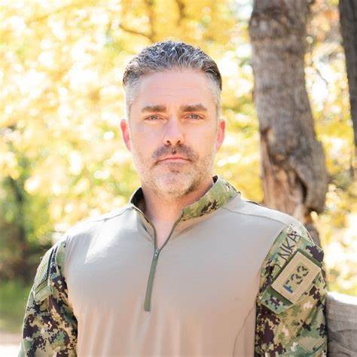
Watch Phillip Koontz: Showreel
Elite Military Background: Phillip Koontz brings to the table an elite military background as a former Navy SEAL with over six years of service. His experience in one of the most revered special operations units in the world lends credibility and authority to his insights on leadership, resilience, and peak performance.
Combat-Proven Leadership: Koontz's time as a Navy SEAL was marked by numerous high-stakes operations in some of the most challenging environments globally. As a leader within his unit, he demonstrated exceptional leadership skills, making split-second decisions under pressure and leading his team to success in the most demanding situations.
Master of Adaptability: SEAL training is renowned for its intensity and unpredictability, requiring candidates to adapt quickly to ever-changing circumstances. Koontz's ability to thrive in such an environment showcases his resilience, adaptability, and mental toughness, qualities that are essential for success both in the military and in civilian life.
Instructor and Mentor: Following his active service, Koontz continued to serve by imparting his knowledge and expertise as an instructor and mentor to the next generation of SEALs. His dedication to training and developing future leaders underscores his commitment to excellence and his desire to pay it forward by shaping the next wave of elite warriors.
Inspiring Speaker: As a sought-after speaker, Phillip Koontz shares his captivating stories and invaluable lessons learned from his time as a Navy SEAL. His dynamic speaking style, coupled with his real-world experiences, resonates with audiences of all backgrounds, inspiring them to overcome obstacles, embrace challenges, and strive for excellence in their own lives.
KEYNOTE TOPICS:
THREE-DIMENSIONAL LEADERSHIP
LIVING FREE AND FEARLESS
OVERCOMING ADVERSITY
PREPARED FOR THE UNKNOWN
PHILLIP KOONTZ
Former Navy Seal
Fee Pending
*Client is responsible for roundtrip airfare, ground transportation, hotel accommodations and incidentals for up to two nights where required.
**Travels from JHB

