Slide 1
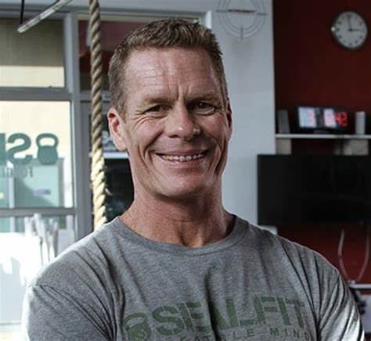
Watch Mark Divine: Failing Forward Fast
Watch Mark Divine: From Navy Seal to Warrior Monk
Founder of SEALFIT and Unbeatable Mind: Mark Divine is the visionary founder of SEALFIT, a program designed to train civilians in the mental and physical resilience techniques used by Navy SEALs. He is also the creator of the Unbeatable Mind Academy, which offers online training in mental toughness, leadership, and personal development inspired by SEAL training principles.
Navy SEAL Career: With over twenty years of experience as a Navy SEAL officer, Mark Divine has a wealth of firsthand knowledge in elite special operations. He served in various SEAL Teams and completed multiple deployments, earning numerous commendations for his leadership and bravery in combat. Divine's extensive experience in the military has shaped his understanding of effective leadership, mental resilience, and peak performance, which he now shares with others through his coaching and speaking engagements.
Bestselling Author: Mark Divine is the bestselling author of several acclaimed books, including "The Way of the SEAL," "Unbeatable Mind," and "Kokoro Yoga.“
Corporate Consultant and Speaker: As a highly sought-after speaker and consultant, Mark Divine brings his unique blend of military expertise, mindfulness practices, and leadership principles to corporate audiences around the world. He has worked with Fortune 500 companies, professional sports teams, and top-tier executives, helping them develop the mental toughness and resilience necessary to thrive in today's competitive business environment. Divine's engaging speaking style and actionable advice inspire audiences to embrace challenges, overcome obstacles, and achieve breakthrough results.
KEYNOTE TOPICS:
Be Unbeatable
The Way of the SEAL
Staring Down the Wolf
A Winning Mindset for the Exponential Age
The Deliberately Developmental Organization
MARK DIVINE
Former Navy Seal – Founder SEALFIT
Fee Pending
*Client is responsible for roundtrip airfare, ground transportation, hotel accommodations and incidentals for up to two nights where required.
**Travels from Carlsbad, California

