Slide 1
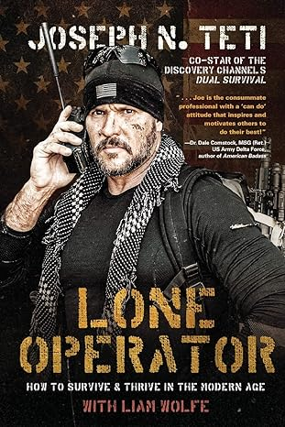
Watch Joe Teti: Talks Dual Survival
Combat Veteran and Special Operations Operator: Joseph Teti is a highly decorated combat veteran with extensive experience in special operations. Serving as a member of the United States Army Special Forces, Teti operated in some of the most challenging and hostile environments around the world.
Survival Expert and Television Personality: Teti gained widespread recognition as a survival expert and television personality, appearing on the hit reality TV series "Dual Survival." Alongside his co-hosts, Teti showcased his expertise in wilderness survival, primitive skills, and tactical preparedness, captivating audiences with his practical knowledge and hands-on approach to survival challenges.
Elite Military Training Instructor: Drawing upon his extensive background in special operations, Teti has served as an elite military training instructor, imparting his knowledge and expertise to the next generation of warriors.
Author and Speaker: In addition to his television career, Teti is also a prolific author and sought-after speaker, sharing his insights and experiences with audiences around the world. Through his books, articles, and speaking engagements, Teti offers valuable lessons on leadership, resilience, and personal development, drawing upon his experiences as a warrior and survivalist to inspire others to overcome obstacles and achieve their goals.
Founder of Advanced Survival Guide: As the founder of Advanced Survival Guide, Teti has established himself as a leading authority on survival and preparedness.
KEYNOTE TOPIC
CRISIS PREPAREDNESS AND AWARENESS FROM A SPECIAL OPERATIONS VETERAN
10 KEY CHARACTERISTICS OF A GREAT LEADER
HOW TO BUILD EFFECTIVE TEAMS
MDMP (MILITARY DECISION-MAKING PROCESS)
THE OODA LOOP
SITUATIONAL AWARENESS AND THE COLOR CODES OF AWARENESS
ADT (ATTENTION TO DETAIL TRAINING) KIMS GAME
JOSEPH TETI Special Ops Veteran
$18,750
*Client is responsible for roundtrip airfare, ground transportation, hotel accommodations and incidentals for up to two nights
Travels from Charlotte, NC

