Slide 1
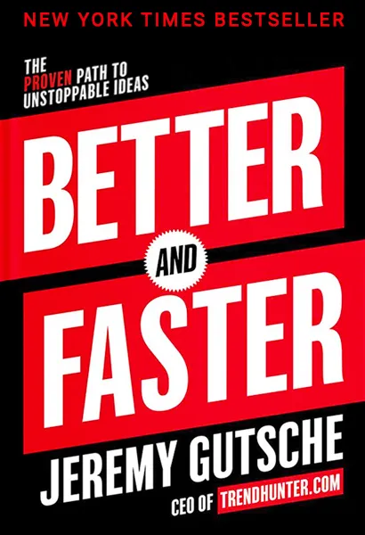
Watch Jeremy Gutsche
Founder & CEO of Trend Hunter – the world’s #1 trend website and innovation consultancy with over 3.5 billion views and 10,000 completed projects with a client list including Google, Disney, Starbucks and NASA
#1 Most-watched innovation keynote speaker, inspiring over 35 million people online and 535,000 at live events
4x author including the NYT bestseller, Better and Faster: The Proven Path to Unstoppable Ideas
Grew a $1 billion portfolio for a bank, studied innovation at Stanford, completed an MBA from Queen’s University
One of Capital One’s youngest business directors and innovation leaders
Keynote Topics:
Innovation Through Chaos – How to Create The Future & Thrive During Change
Disrupt or be Disrupted – Learn to Spark Innovation and Change
Creating a Culture of Innovation
The Super Future & AI Keynote
Better & Faster Innovation Keynote
ADAPT & DISRUPT: CAPTURE NEW BUSINESS OPPORTUNITIES AND STAY AHEAD OF THE PACK
How to Make Change Happen When Change is Hard
CREATING A CULTURE OF CUSTOMER OBSESSION
How to Make Messages that Stick, Sell and Persuade
Jeremy Gutsche
Founder and CEO of Trend Hunter
Fee: $55,000++
*Client is responsible for business class, round-trip airfare, ground transportation, hotel accommodations and incidentals for up to two nights

