Slide 1
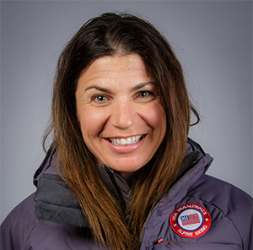
Watch Danelle Umstead: Deloitte Feature
Diagnosed with Retinitis Pigmentosa, a genetic eye condition where the retina progressively degenerates and eventually causes blindness at the age of 13
Has no central vision, is losing her peripheral vision and her spotted vision limits her sight to less than five feet without any detail, yet she continued to defy odds in adaptive skiing which she was introduced to in 2001
Severe vision loss requires her to ski with a guide, her husband Rob, together they make up Team Vision4Gold
Duo made history at the 2010 Vancouver Winter Paralympic Games as the first husband and wife visually impaired ski race team to compete and medal for Team USA
The dynamic pair have won 3 Paralympic Bronze medals, 4 World Championship medals, and over 50 Alpine Skiing World Cup medals
Diagnosed with Multiple Sclerosis soon after the 2010 Paralympic Games, refusing to let it deter her training and continuing to compete even winning a bronze medal in the 2017 World Para Alpine Skiing Competition
KEYNOTE TOPIC:
HOW TO DO THE IMPOSSIBLE EVERY DAY
DANELLE UMSTEAD
Paralympian
Fee: $16,500
*Client is responsible for round-trip airfare, ground transportation in event city and hotel accommodations for up to (2) nights

