Slide 1
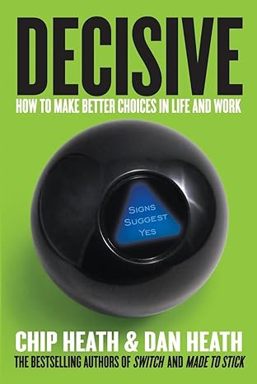
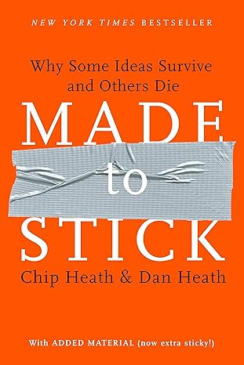
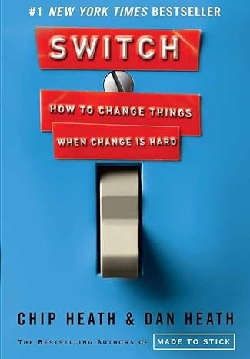
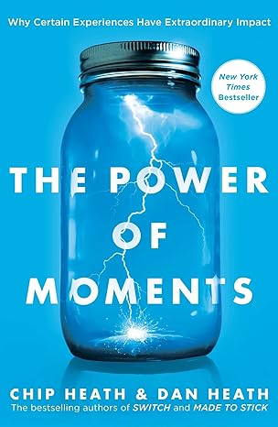
Watch Dan Heath
Senior Fellow at Duke University’s CASE center, which supports entrepreneurs who fight for social good
Co-author of 4 New York Times bestselling books, Made to Stick, Switch, Decisive, and The Power of Moments, which have sold over $3 million copies combined
In 2020 released the book Upstream: The Quest to Solve Problems Before They Happen which studies leaders who have escaped the cycle of reaction and triumphed in preventing major problems
Books have been praised by a wide variety of media sources including Harvard Business Review, U.S. Army and People magazine
Co-founder of Thinkwell, an innovative education company
In 2013, was named to the Thinkers50 list of 50 most influential management thinkers
Keynote Topics:
UPSTREAM: THE QUEST TO SOLVE PROBLEMS BEFORE THEY HAPPEN
CREATING MOMENTS THAT MATTER
LEADING A SWITCH
MAKING IDEAS STICK
BEING DECISIVE
DAN HEATH Bestselling Business Author
Fee: TBC
*Client is responsible for business class, round-trip airfare, ground transportation in home and event cities, hotel accommodations and incidentals for up to two nights

