Slide 1
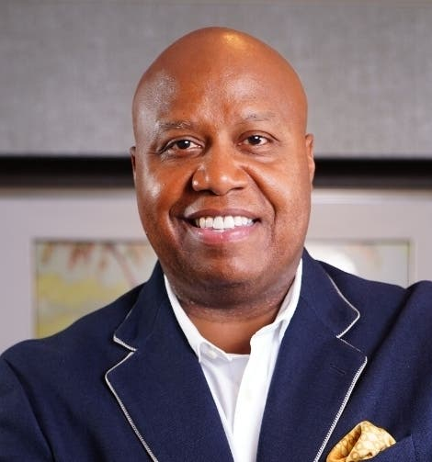
Watch Walter Bond: 2024 Sizzle Reel
Facing injuries and other challenges with unusual determination, Walter rose from the bench to become the first rookie Free Agent to start for the Dallas Mavericks
8-year NBA career paying with the Dallas Mavericks, Utah Jazz, and Detroit Pistons followed by time as a broadcast analyst for the Minnesota Timberwolves
Nicknamed “Mr. Accountability” because he compels audiences to take personal responsibility for their current situation and reveals how to harness and apply the power of accountability so that every listener can become a rock star in his or her industry
Nationally recognized public speaker with simple but powerful principles, smooth delivery, humorous stories, and authentic breakthroughs leaving his audience to feel changed, motivated and inspired
In his newest book, Swim! (How a Shark, a Suckerfish, and a Parasite Teach You Leadership, Mentoring, and Next Level Success), released in July 2019, Walter dives deep into the concepts of mentorship and the power of human connection
Keynote Topics:
Creating a Culture of High Performance
No One Can Stop You But You
Shark Mindset: The Story of the Shark, The Suckerfish and the Parasite
WALTER BOND
Former NBA Player, Business Coach
Fee: $35,000
*Client is responsible for $2,750 travel buyout

