Slide 1
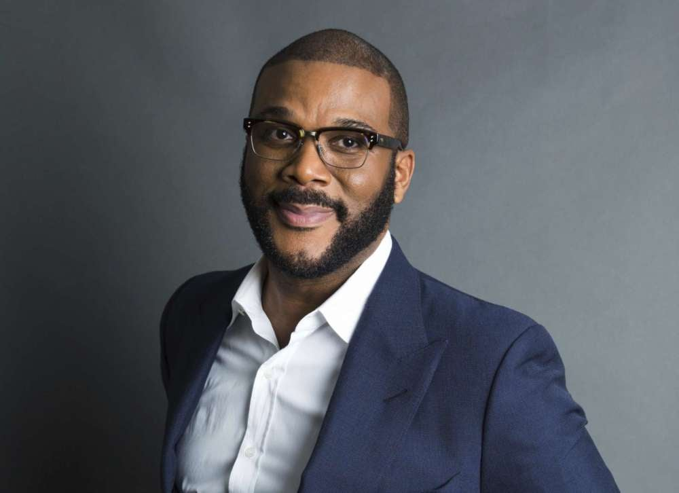
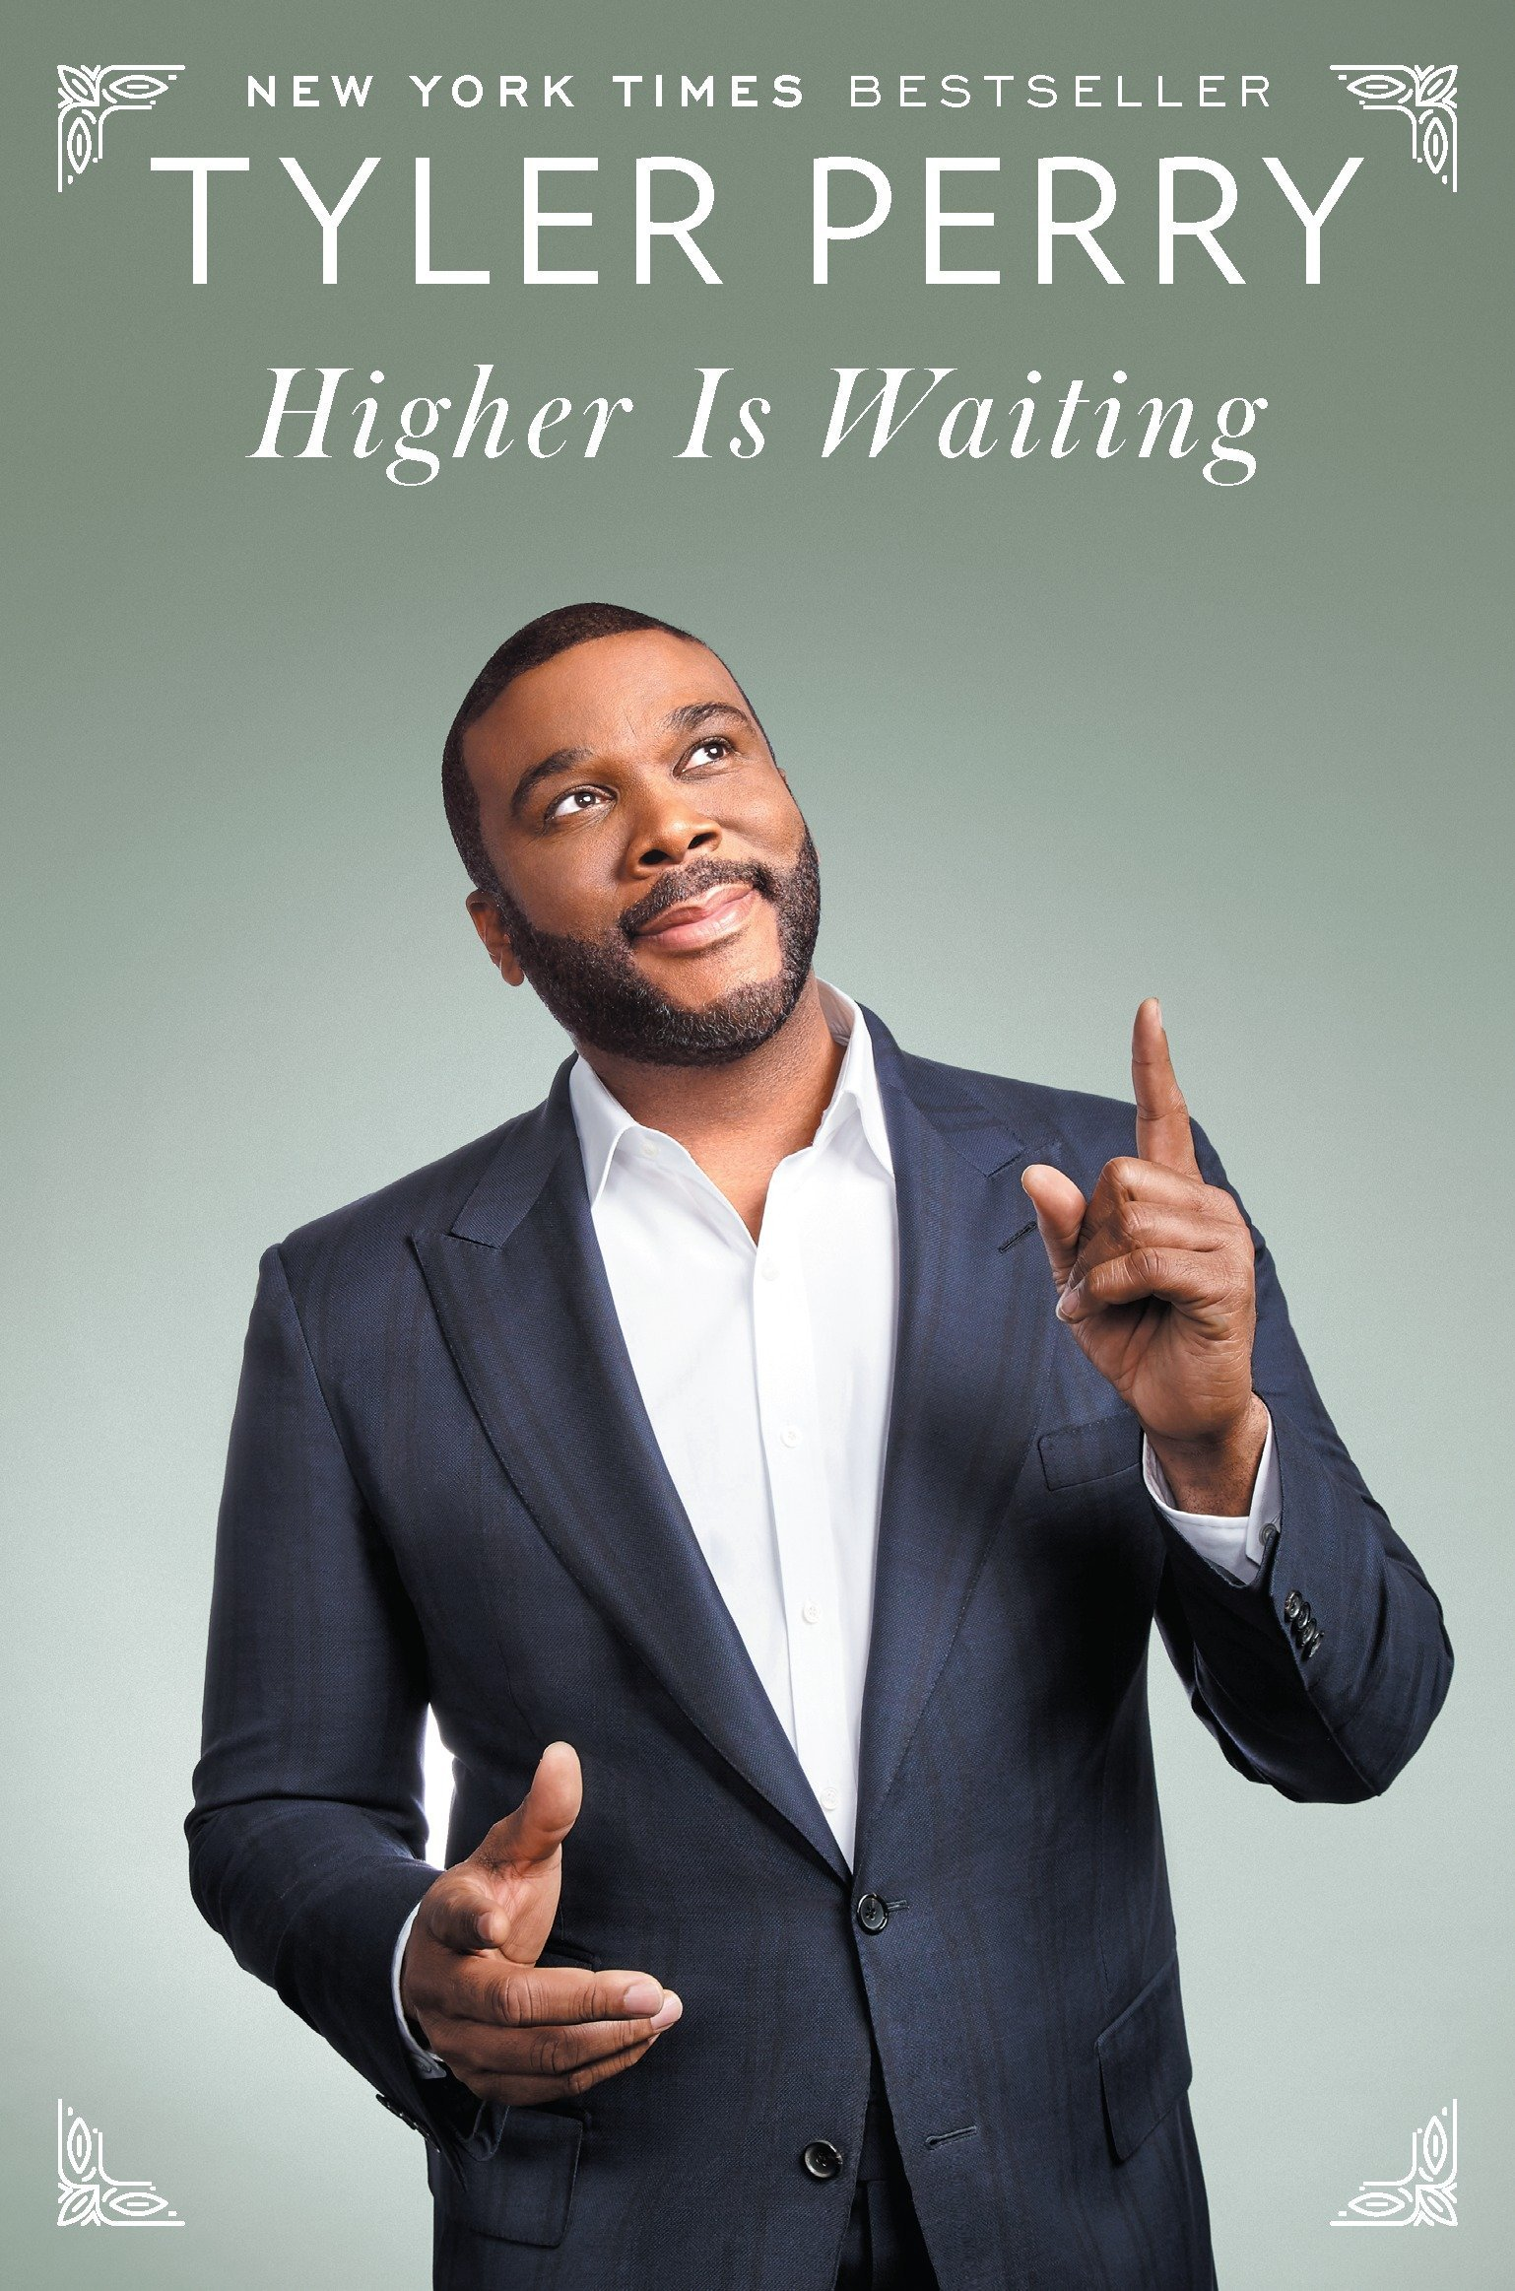
Watch Tyler Perry: Life Lessons for Goldman Sachs
Watch Tyler Perry: How He Build His Media Empire
One of the most established media personalities today, recognized for his work as an actor, director, screenwriter, producer, playwright, and author
Started his career writing plays, many of which later became the inspiration for his film projects and included the introduction of the now-legendary Madea character, played by Tyler himself
First feature film, Diary of a Mad Black Woman, debuted at number one nationwide; ensuing films include Madea's Family Reunion, Why Did I Get Married?, Meet The Browns, I Can Do Bad All by Myself, For Colored Girls, Good Deeds, The Single Mom’s Club, A Madea Family Funeral, Gone Girl, Vice and more and have grossed more than $660 million
The first African American man to ever be at the helm of a major studio with the historical opening of Tyler Perry Studios in Atlanta
Included in in TIME’s list of the 100 most influential people of 2020, received the Emmy Award's Governors Award in 2020, the Jean Hersholt Humanitarian Award in 2021 and was inducted into the Black Music & Entertainment Walk of Fame in 2022
Key Takeaways:
Opens up about his journey from poverty to fame and fortune, discussing what it took to build his empire, the purpose behind his films and characters and representation in the media
TYLER PERRY
Media Mogul
Fee Pending
*Client is responsible for round-trip private airfare, ground transportation in event city, hotel accommodations and incidentals for up to two nights

