Slide 1
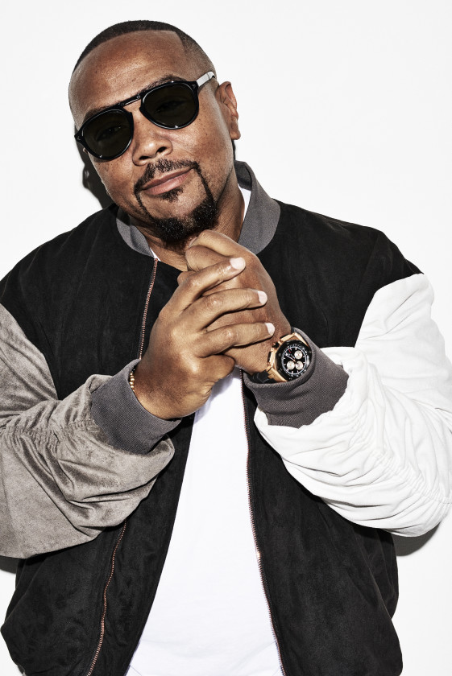
Watch Timbaland: How He Revolutionized R&B + Hip-Hop and Reinvented Himself
Watch Timbaland: Interview with Tamron Hall
Dubbed the Emperor of Sound, he is a musical mastermind behind countless hits of our time from some of the most legendary artists including Jay-Z, Kanye West, Justin Timberlake, Madonna, Beyoncé, Katy Perry, Mariah Carey, Rihanna, Sam Smith, Maluma, Brad Paisley, Coldplay, Destiny’s Child, Ludacris, Snoop Dogg, Drake, Alicia Keys and countless others
Ranked #3 by Billboard on a list of 50 of the greatest producers of the 21st century with credits which have established him as one of the most iconic producers in the last 30 years
Over 18-Grammy nominations, 4-Grammy wins and 200+ ASCAP Music awards, over 40M albums and 50M singles sold under his label, Mosley Music
Collaboration with Justin Timberlake is one of the most successful and iconic partnerships of all time, producing several popular hits selling over 30M albums worldwide including the mega-hit “Sexy Back” which sold over 6M copies
Founded a new label, Mosley Music, in 2006 debuting with Nelly Furtado’s “Promiscuous,” featuring Timbaland which hit #1
Author of two books, a biography aptly titled The Emperor of Sound, and his children’s book Nighttime Symphony
Co-creator of pandemic phenomenon Verzuz with super producer Swizz Beats and co-founder of the music tech platform Beatclub which has exclusive partnerships with superstars such as J Cole, Justin Timberlake and more
TIMBALAND
Producer + Recording Artist
Fee: $60,000
*Client is responsible for round-trip airfare, ground transportation in event city, hotel accommodations and incidentals for up to two nights

