Slide 1
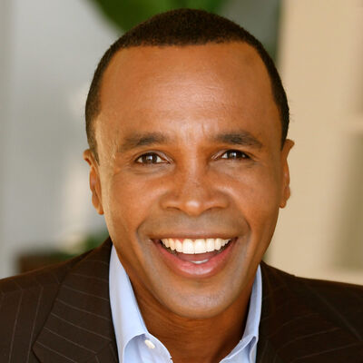
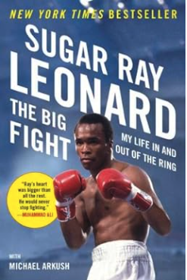
Watch clip of Sugar Ray Leonard's Power to Win
Sugar Ray Leonard Discusses His Incredible Life Journey
Sugar Ray Leonard is an Olympic athlete and world champion boxer, Sugar Ray Leonard shows us how to set our fears of the unknown aside with preparation, focus, discipline, determination and attitude.
Leonard took home Olympic gold and fought his way to world championships in five weight classes, a record still standing today.
Voted “one of the top 25 athletes of the last 25 years” by ESPN, he is a successful entrepreneur who started his own sports promotion firm.
In 2009, Leonard and his wife founded the Sugar Ray Leonard Foundation to raise funds for research and awareness for a cure for Type 1 Diabetes and to help children live healthier lives through diet and exercise.
Leonard’s raw and uplifting memoir, The Big Fight, reveals in intimate detail for the first time the complex human who waged his own personal battle with depression, rage, addiction, and greed, that lay behind the champion.
Key Takeaways:
Sugar Ray uses his success qualities of discipline, focus, determination, preparation, and the right attitude to inspire audiences to commit to being and delivering their best.
Sample Keynotes:
The Power to Win!
Fitness and Philanthropy
SUGAR RAY LEONARD
Legendary Boxer, Olympic Gold Medalist & Best-Selling Author
$50,000
*Client is responsible for first class roundtrip airfare, ground transportation, hotel accommodations and incidentals for up to two nights

