Slide 1
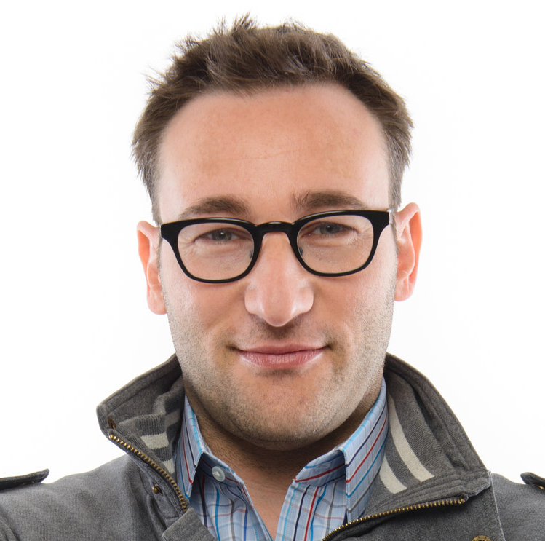
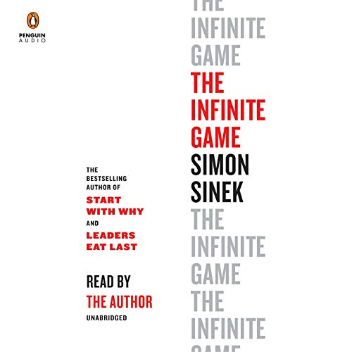
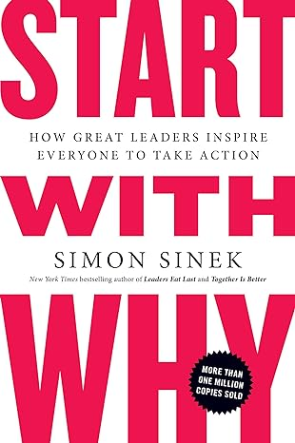
Watch Simon Sinek: Responsible Leadership for Infinite Success
Described as “a visionary thinker with a rare intellect,” he is an unshakable optimist who believes in a bright future and our ability to build it
Driven by a bold goal to help build a world in which the vast majority of us wake up inspired, feel safe at work and return home fulfilled at the end of the day, he is leading a movement to inspire people to do the things that ignite their passion, creativity, and joy
Author of global bestselling books The Infinite Game, Start with Why and Leaders Eat Last among several other New York Times and Wall Street Journal bestsellers
Fascinated by the leaders who make an impact on the world and the companies and politicians with the capacity to inspire, his work focuses on the remarkable patterns in how such people and organizations think, act and communicate
best known for popularizing the concept of WHY in his first TED Talk in 2009 which rose to become one of the most watched TED talks of all time, with over 43 million view
Interview on Millennials in the workplace broke the Internet in 2016, garnering over 200 million views in the first month leading his name to being YouTube’s fifth most searched term in 2017
Keynote Topics:
Infinite Game
How to discover your “why” in difficult times
SIMON SINEK Technology Expert, Journalist
Fee: $350,000 +

