Slide 1
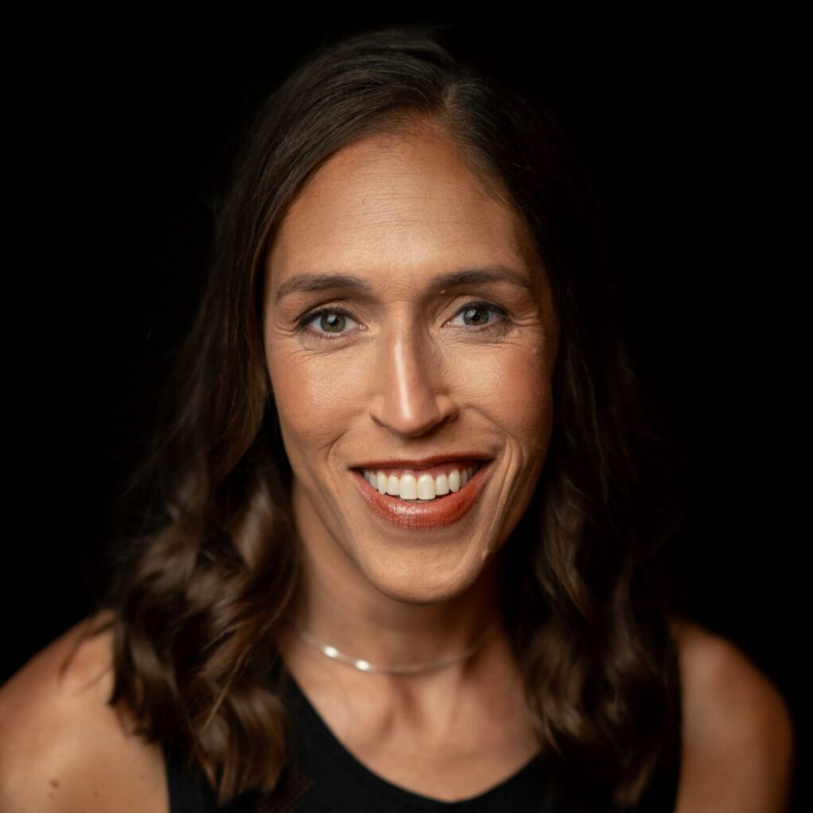
Watch Rebecca Lobo: Hall of Fame Speech
Watch Showreel
Named Female Athlete of the Year by the Associated Press, NCAA Women’s Basketball Player of the Year, Woman of the Year by the Women’s Sports Foundation, and she also received an ESPY for Outstanding Female Athlete
Inducted into the Women’s Basketball Hall of Fame in 2010 and was named to the Naismith Memorial Basketball Hall of Fame in 2017
Joined ESPN in 2004 as a WNBA and women’s college basketball analyst and reporter
Co-authored The Home Team Of Mothers, Daughters, and American Champions with her mother RuthAnn, the book covers her career as well as her late mother’s battle with breast cancer
Rebecca Lobo is a former WNBA All-Star and championship-winning college athlete whose career gained her many accolades including a gold medal as a part of the 1996 U.S. Women’s Basketball Summer Olympic team.
Lobo was one of the first players to sign with the WNBA and where she remained for 6 years, paving the way for future female athletes to be recognized as professional basketball players.
Key Takeaways:
Details her story from college basketball superstar to Olympian and shares her experiences as one of the first female players to sign with a professional team
Rebecca Lobo
WNBA Legend
Fee: Pending
*Client is responsible for round-trip, first class airfare, ground transportation in home and event cities, hotel accommodations and incidentals for up to two nights
** Travels from Connecticut

