Slide 1
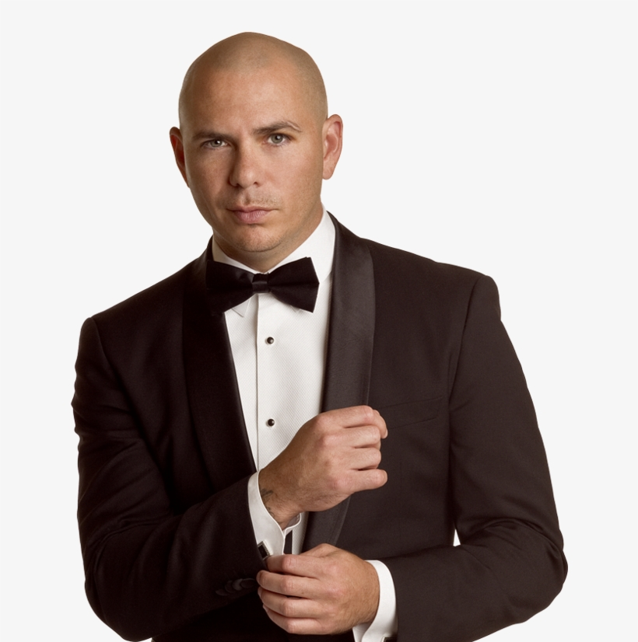
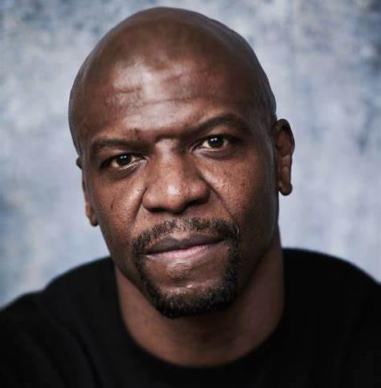
Watch Pitbull: Fireside Chat for eMerge Americas Conference
Grammy award winning performer who has sold over 70 million singles while establishing himself as an entrepreneur, a philanthropist, a motivational speaker, and an international sensation
Born to Cuban-American expatriates, Pitbull’s motto is to “turn a negative into a positive,” and this mindset has instilled in him a tenacity that fuels his drive for success.
Serves as an ambassador for SLAM!, the Sports Leadership and Management charter schools he has helped to establish
Has been the subject of specials for CNBC, CNN, CBS, NBC, ABC and more; he has made appearances on Empire, Shark Tank and Dancing with the Stars and his music has appeared in Men In Black III and The Penguins of Madagascar, and he even had a starring voiceover role in the animated 3D movie Epic
Accolades include landing # 1 hits in over 15 countries, 10 billion YouTube/VEVO views, 70 million single sales and 6 million album sales, and over 20 million social media followers
Creator of Voli 305 vodka and the fragrance line “Pitbull”
Keynote Topics:
Fireside Chat with Pitbull
PITBULL
Grammy Award Winning Performer, Entrepreneur
Fee: $240,000 - #350,000
*Client is responsible for private jet, ground transportation, hotel accommodations and incidentals for up to two nights for 3 people
**Travels depends where he is performing from.

