Slide 1
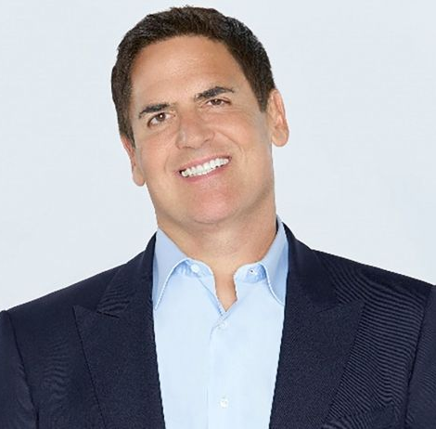
Watch Mark Cuban: Talk Crypto with Mark & Moe
Watch Mark Cuban: How I became a Billionaire
Billionaire entrepreneur, television personality and media proprietor who is recognized as one of the most prominent figures in business today
Demonstrated his business savvy early on as a kid, tackling all kind of business challenges and schemes, from selling garbage bags to money making chain letters to selling and collecting stamps
Invested in hundreds of companies including IceRocket, RedSwoosh, Webblogs, Inc., Brondell Inc., Goowy Media Inc., Veldskoen and even purchased the entire town of Mustang, Texas in 2021
Among the top 500 people on the world’s richest people list in Forbes Magazine
Owner of the Dallas Mavricks NBA team
Owner of the entertainment companies Landmark Theaters, 2929 Entertainment, Magnolia Pictures and AXS TV
Serves as a “shark” investor on the ABC’s television series Shark Tank
MARK CUBAN Business Guru
$300,000+
*Client is responsible for first class, round-trip airfare, ground transportation, hotel accommodations and incidentals for up to two nights

