Slide 1
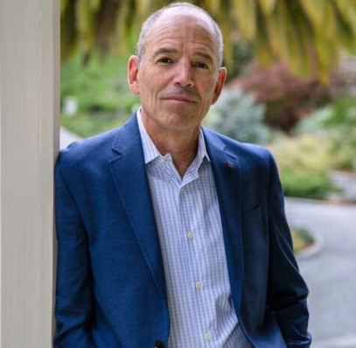
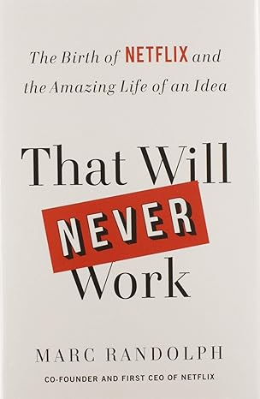
Watch Marc Randolph: Sizzle Reel
Veteran Silicon Valley entrepreneur, advisor and investor
Co-founder of Netflix, serving as the founding CEO, as the executive producer of the web site, and as a member of the board of directors
Career as an entrepreneur spans more than four decades and includes founding or co-founding more than half a dozen other successful start-ups, mentored rising entrepreneurs including the co-founders of Looker Data which was recently sold to Google for $2.6B
Committed to working with young entrepreneur programs, sits on the board of the environmental advocacy group 1% for the Planet, and chairs the National Outdoor Leadership School’s Board of Trustees
Memoir, That Will Never Work: The Birth of Netflix and the Amazing Life of an Idea, chronicles the journey of Netflix from an eight-employee startup in 1997 when DVDs had just entered the U.S. market to the pivotal moment in 1998 when Hastings and Randolph considered selling Netflix to Amazon
Keynote Topics:
Netflixed: How A Scrappy Silicon Valley Startup Brought Down Blockbuster and Built One of the World’s Best-Known Brands
Fireside Chat with Marc Randolph
MARC RANDOLPH
Expert Investor, Entrepreneur
$100,000+
*Client is responsible for first class, round-trip airfare, ground transportation in event city, hotel accommodations and incidentals for up to two nights

