Slide 1
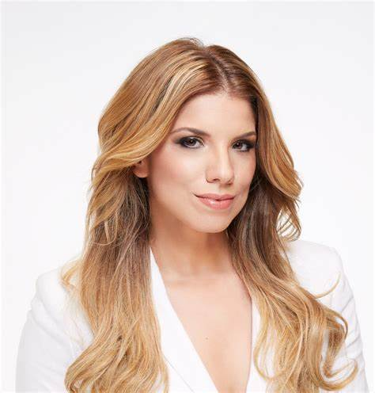
Watch Gaby Natale: TED - Pioneer: How to Be What You Can't See
Watch Gaby Natale: #WeAllGrow Storytellers Summit
3X Emmy-Winning Journalist and Bestselling Author Gaby Natale is on a mission to awaken the PIONEER spirit in each of us.
Among just a few women in the entertainment industry who not only owns the rights to her media content, but also a television studio, this unique situation has allowed her to combine her passion for media and her entrepreneurial spirit, which continues to help her break barriers
Her book, The Virtuous Circle, became an instant bestseller, topping Amazon’s New Releases charts in 3 different categories and made her the first Latina author to be published by the leadership division of HarperCollins
Has been featured in Forbes, CNN, Buzzfeed, NBC News, Univision and Latino Leaders magazine. In 2018,
People magazine named her one of the “25 Most Powerful Latinas” in 2018, highlighting the inspirational story of how she went from a local TV show that started out of a carpet warehouse to becoming the only Latina in US history to win triple back-to-back Daytime EMMYs
Thriving fan base consists of over 52 million views on YouTube and 250K+ followers on social media
Founder of AGANARmedia, a marketing company with a focus on Hispanic audiences that serves Fortune 500 companies such as Hilton Worldwide, Sprint, AT&T, eBay and Amazon
GABY NATALE
Barrier Breaking Media Personality
Fee Pending
*Client is responsible for round-trip airfare, ground transportation in event city, hotel accommodations and incidentals for up to two nights

