Slide 1
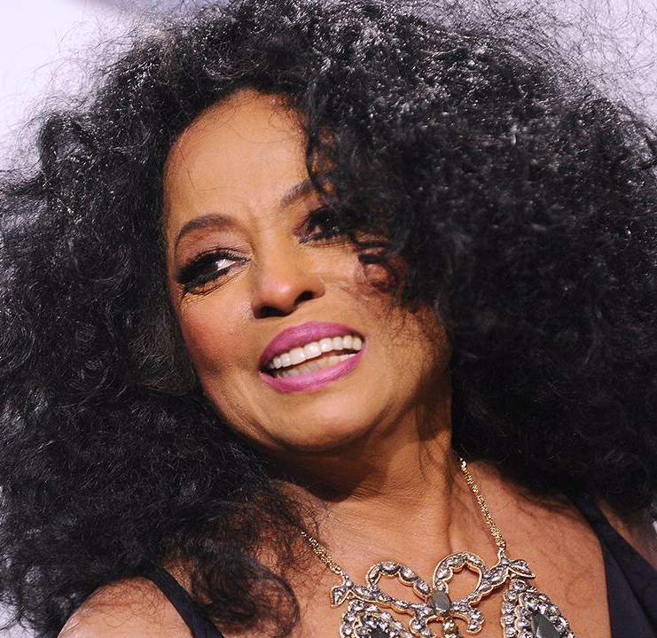
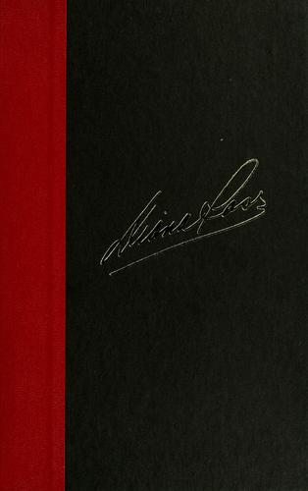
Watch Diana Ross: Talks Her Memoirs
Lead singer of The Supremes, earning 14 No. 1 hit singles on the U.S. Billboard Hot 100 throughout her remarkable career spanning over 3 decades earning her the designation o one of the most successful female singers of all time
Won a Golden Globe for her role as Billie Holiday in “Lady Sings the Blues”, the same role for which she also received an Academy Award nomination
Recipient of BET's “Lifetime Achievement Award“
Serves on the board of directors for A Better Chance, which helps inner-city children gain access to the nation’s top college preparatory schools
Authored and published her long awaited memoirs, Secrets of a Sparrow
Sits on the board of directors of A Better Chance, the oldest and only national program that provides a variety of educational opportunities to academically talented children and is a spokesperson for National Children's Day, a day in which children have the opportunity to share their hopes and concerns with America's leaders
Key Takeaways:
Chronicles her legendary career and inspires audiences with her stories of building a reputation as an icon and the importance of giving back to the community
DIANA ROSS
Music Icon
$1,000,000+
*Client is responsible for round-trip private airfare, ground transportation in event city, hotel accommodations and incidentals for up to two nights

