Slide 1
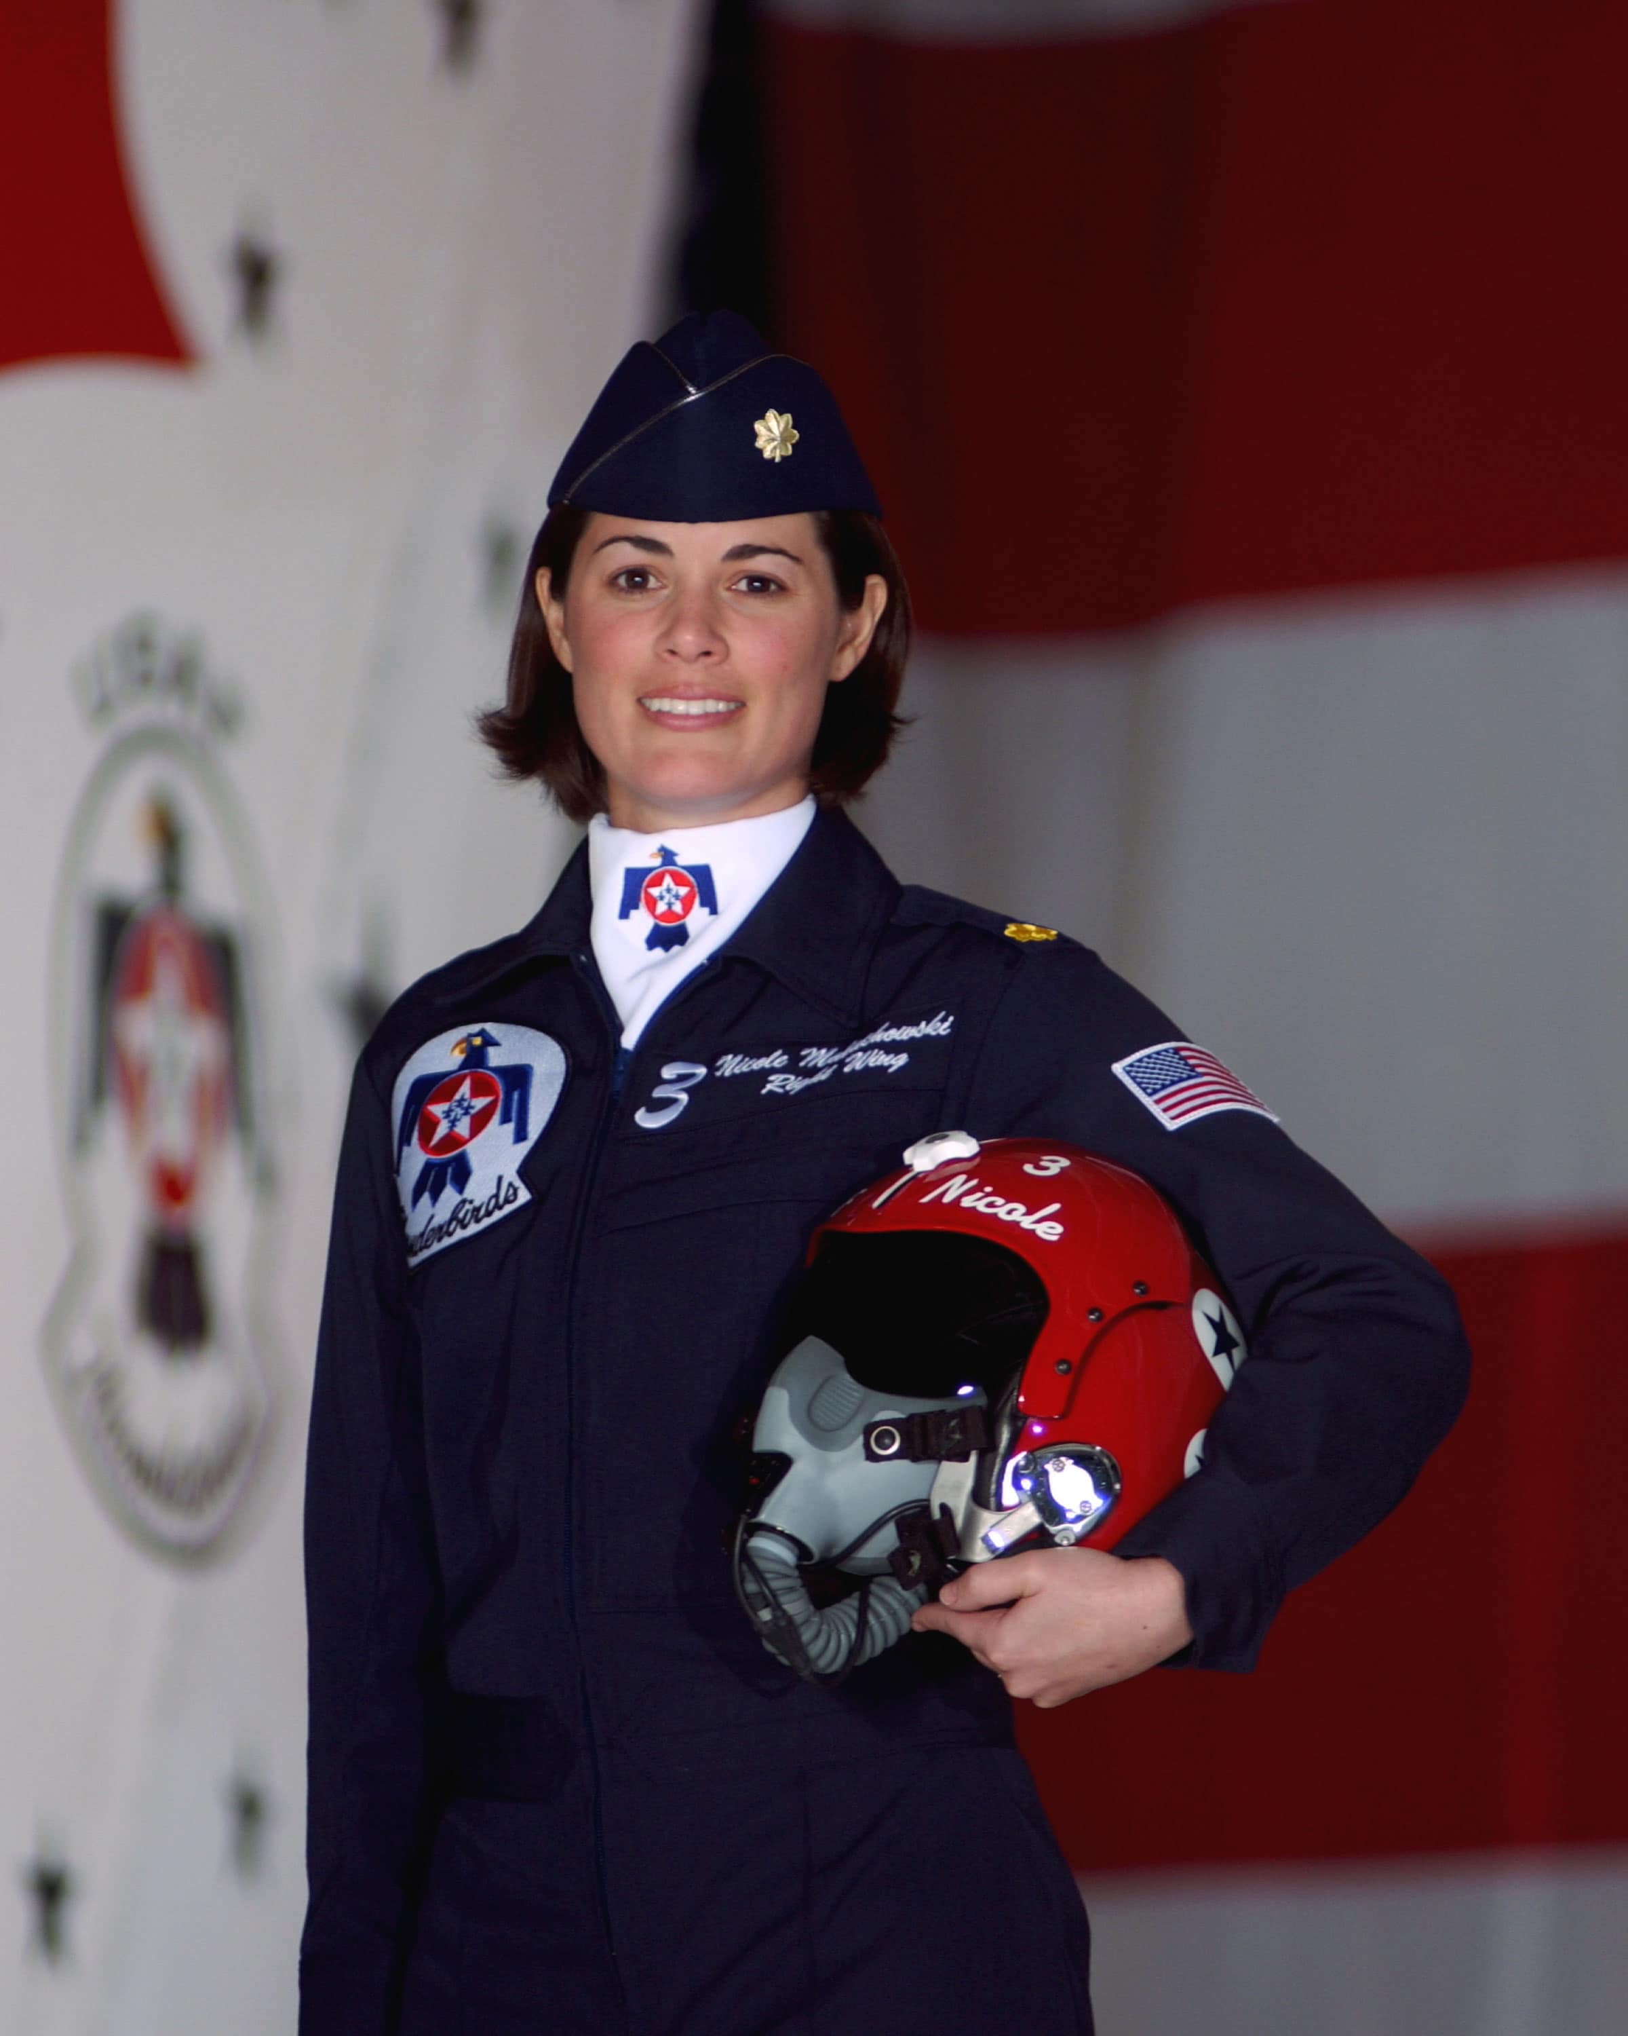
Watch Nicole Malachowski
First woman pilot on the Thunderbirds Air Demonstration Squadron
White House Fellow, and an inductee into both the National Women’s Hall of Fame and the Women in Aviation International Pioneer Hall of Fame
Following a distinguished 21 year Air Force career, Nicole experienced a devastating tick-borne illness which left her struggling greatly to speak or walk for almost nine months
Inspires audiences with three key beliefs: failure and risk is the price of entry for achieving something great; sometimes you need to yield to overcome; and her personal mantra – “Nobody wants to lead a scripted life.”
A leader who has achieved greatness, faced overwhelming adversity and challenges and has come out on top, Nicole leaves audiences spellbound
Keynote Topics:
Harnessing Headwinds of Change
Pushing the Envelope: Being the Best When It Counts
Breaking Barriers: Conquering Self-Doubt and Cultural Paradigms
Leading Successful Change
NICOLE MALACHOWSKI U.S. Air Force Combat Veteran
Fee: Pending
*Client is responsible for business class, round-trip airfare, ground transportation, hotel accommodations and incidentals for up to two nights

