Slide 1
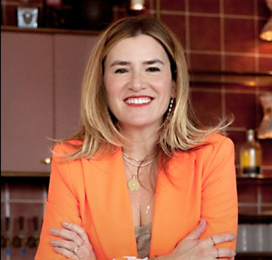
Watch Alli Webb
Watch Alli Webb: Sizzle Reel
Named president of Canopy, a beauty and wellness humidifier brand, in early 2022
Founded Drybar in 2010, a chain of blowout-only hair salons that sparked a beauty revolution and now has over 150 locations in the US
Diversified the Drybar brand, creating a link of products and tools sold at popular retailers including Nordstrom, Sephora and Ulta, recently selling the division to Helen of Troy for $225M
Co-founder of Squeeze, an innovative massage business, and Becket + Quill, a jewelry company
Graced the cover of Inc Magazine’s “How I Did This” issue, named the 100 Most Creative People in Business by Fast Company, featured on Fortune magazine’s 40 Under 40 list, Marie Claire’s Most Fascinating Women and recently Inc. magazine recognized her as one of The 100 Women Building America’s Most Innovative and Ambitious Businesses
Appeared on season 10 of ABC’s Emmy nominated hit show “Shark Tank” as a guest shark in 2019
ALLI WEBB
Founder of Drybar
Fee: $60,000++
*Client is responsible for ground transportation
in event city

