Slide 1
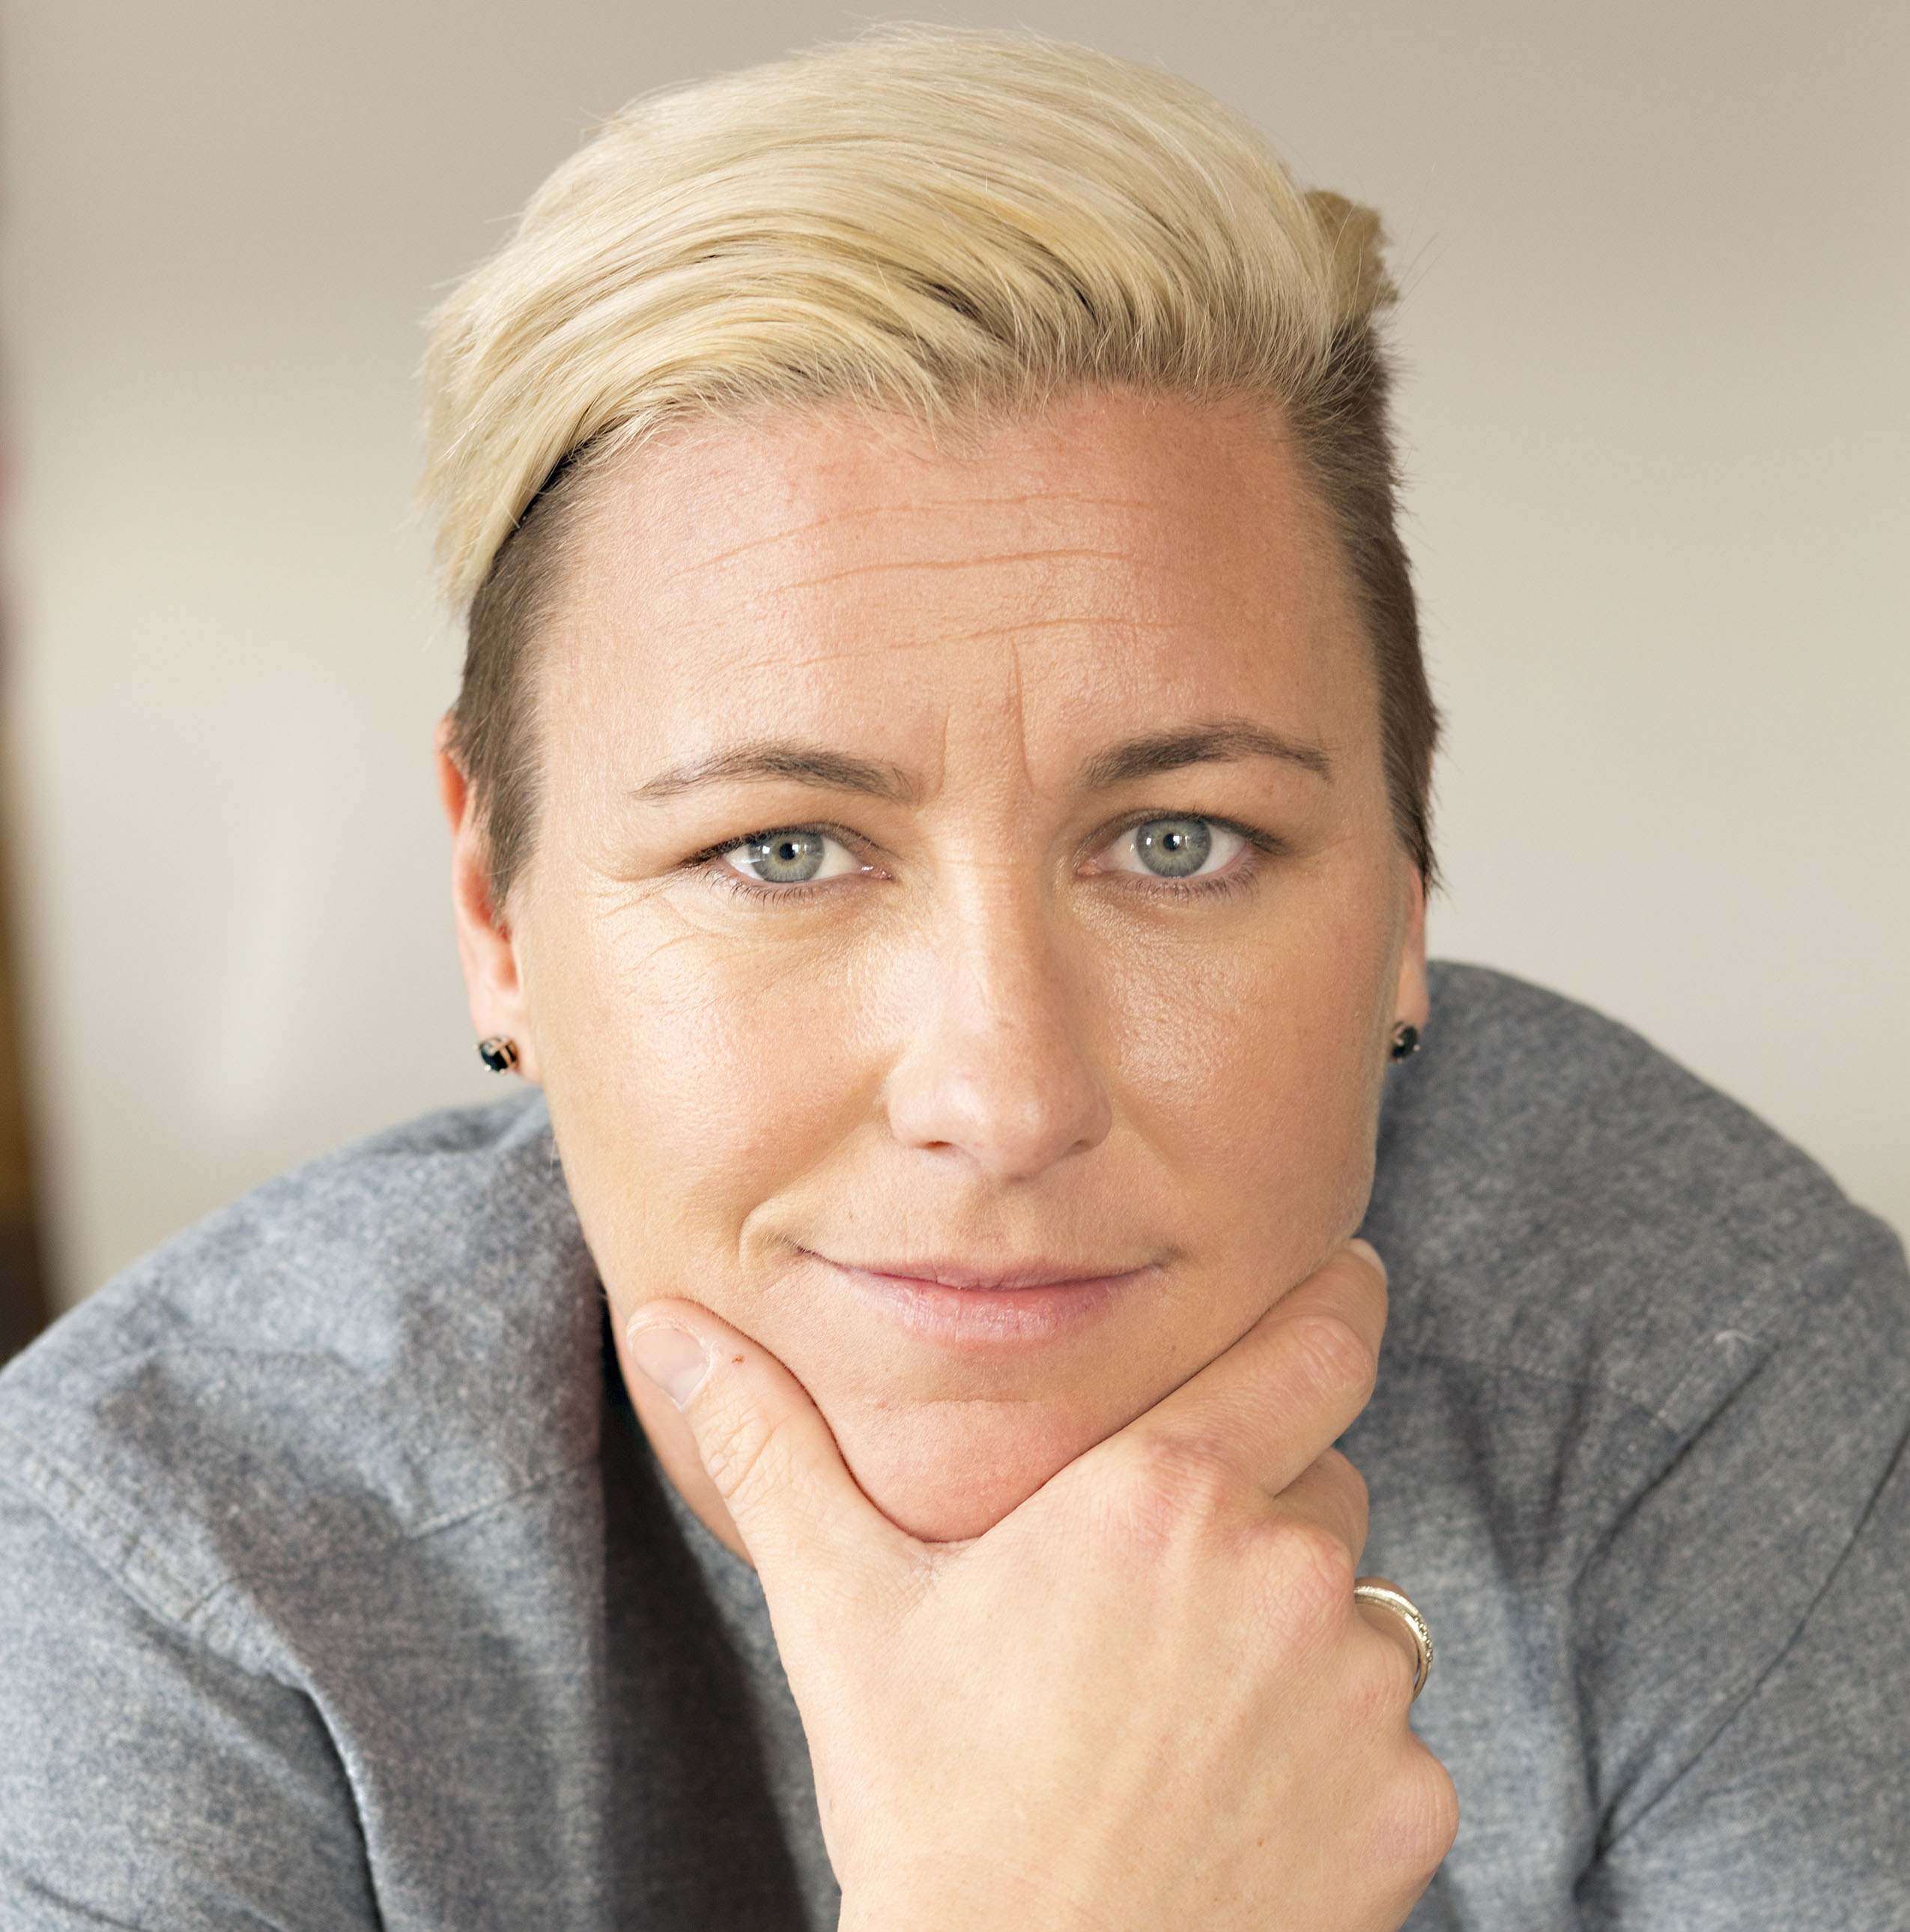
Watch Abby Wombach: Keynote Address for Barnard College
Watch Abby Wombach: Keynote for Watermark Conference for Women
In 2012, won an Olympic gold medal, served as team co-captain and was the leading scorer for the USA women’s soccer team and was named FIFA Women’s World Player of the Year
Broke Mia Hamm’s all-time international goal scoring record in 2013
FIFA Women’s World Plater of the Year in 2012 and FIFA Women’s World Cup Champion in 2015
Received the ESPYS Icon Award in 2016
Released Forward: A Memoir which hit the New York Times Bestsellers list in 2016
Serves as a leading advocate for women’s equal pay and co-founded Wolfpack Endeavor which is revolutionizing leadership development for women in the workplace
Sample Keynote Topics:
Leading to Win
Remarks By Abby: Remarks on Leadership, Teamwork, Resilience and Gender Equality
ABBY WAMBACH
Olympic Gold Medalist
Fee: $150,000
*Client is responsible for unrestricted first-class roundtrip airfare, professional ground transportation in home and event cities, hotel accommodations and incidentals for up to two nights

