Slide 1
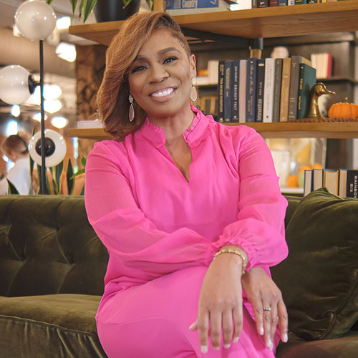
Watch Wendee Lee Curtis: Host/Emcee/Moderator Reel
Watch Wendee Lee Curtis: Commercial for Kohl's
Veteran news anchor and Broadway performer bringing the art of news-level production, live entertainment and the magic of connection to events
Experience in both the corporate and theatrical worlds makes her an ideal presenter, host and keynote speaker using her expert knowledge and well-rounded background to engage audiences
Highlights of her on-camera experience includes interviewing Joe Jackson for the documentary “Making Michael”, the EPIC Conference with Billy Porter, interviews with Liza Minnelli, Wayne Brady, Al Green, Tony Danza and Miranda Lambert among others
Has hosted live events for WeTV, Disney’s Family Chick Chat: a Girl’s Guide to Life with Teri Hatcher, Tone Network’s “Tone Talks” and CCA Live
Passion for entertainment, adventure, travel and community has allowed her to cultivate a storytelling approach and connect with audiences from all over the world on a high level
KEYNOTE TOPICS
The Broadway Blueprint™: Building Belonging
Connected Confidence
WENDEE LEE CURTIS
Fe: $9,500
Client is responsible for round-trip airfare, ground transportation in event city and hotel accommodations for up to (2) nights

