Slide 1
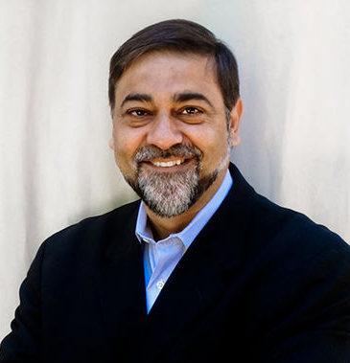
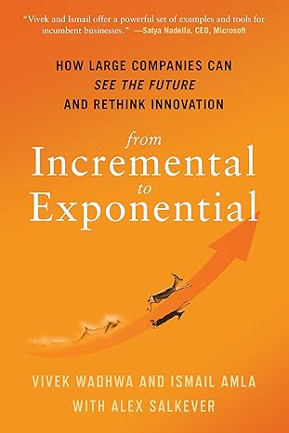
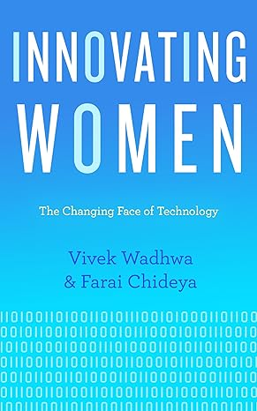
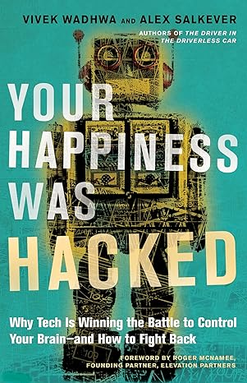
Watch Vivek Wadhwa: Amazing or Scary? Technology's Impact on Our Lives, Jobs and Business
Listed as one of the “40 Most Influential Minds in Tech” by TIME magazine
Described as “Silicon Valley’s most provocative voice” for his ideas on technology trends, globalization, US competitiveness, and the future
Has served as a Stanford University research fellow and the Director of Research at Duke University’s Pratt School of Engineering, where he taught courses on the impact of technology
Author of 5 books including the 2017 book The Driver in the Driverless Car, which was recognized by Financial Times as one of the “Best Business Books of 2017”
Work focuses on the keys to the US remaining competitive and solving grand challenges in the face of the rapid transformation shaping business in India, China, and Latin America
Syndicated columnist for The Washington Post and a contributor to The Wall Street Journal, The Huffington Post, and VentureBeat
Keynote Topics:
Navigating Technological Change at Light Speed
Disruption and Technology
How Technology will Eat Medicine
VIVEK WADHWA
Innovation and Change Pioneer

