Slide 1
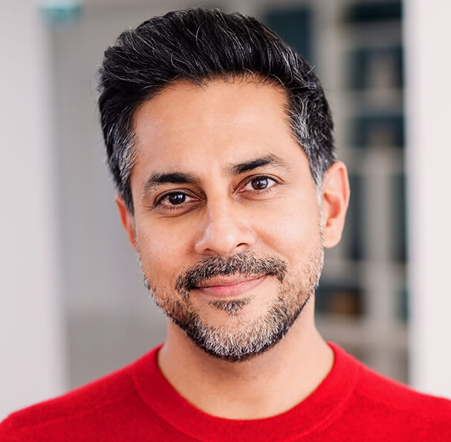
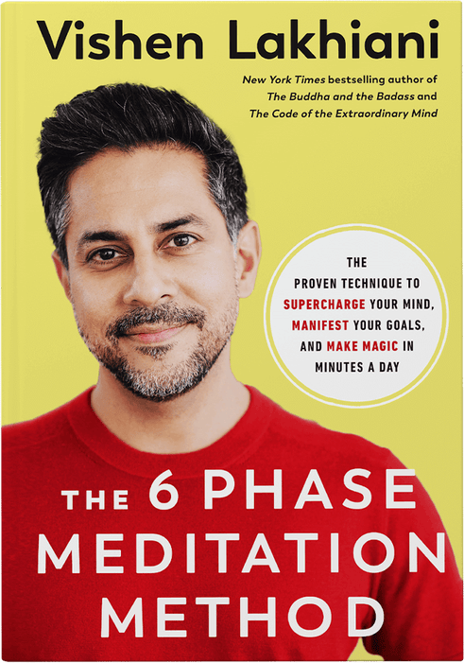
Watch Vishen Lakhiani: Speaker Reel
Watch Vishen Lakhiani: How to Find Your Contribution to the World Today
Founder of Mindvalley, an award-winning education movement with millions of students worldwide that publishes ideas and teachings by the best authors in personal growth, wellbeing, spirituality, productivity, mindfulness and more
Started A-Fest in 2010, a transformational festival he merged with Mindvalley, creating another component called Mindvalley University giving the company two major event experiences in the field of personal transformation
3X author including the New York Times Bestselling book The Code of the Extraordinary Mind: 10 Unconventional Laws to Redefine Your Life & Succeed On Your Own Terms, now translated into over 25 languages
Creator of Mindvalley Quests, a new kind of online learning platform that produces 800% better completion rates than the industry average
​
Key Takeaways:
Talks forgiveness, self-love and being in the now as tools to enhance the human experience and make us more resistant to the ups and downs of life
Motivates audiences with the “3 Most Important Questions” exercise, leaving guests with a clear picture of their boldest dreams and hopes for their life
Sample Keynote Topics:
The 6 Phase Meditation
Goals & Dreaming Big
3 Ways to Become Unfuckwithable
VISHEN LAKHIANI
Founder of Mindvalley, Bestselling Author, Personal Transformation Expert
Fee: Pending
*Client is responsible for round-trip airfare, ground transportation, hotel accommodations and incidentals for up to two nights

