Slide 1
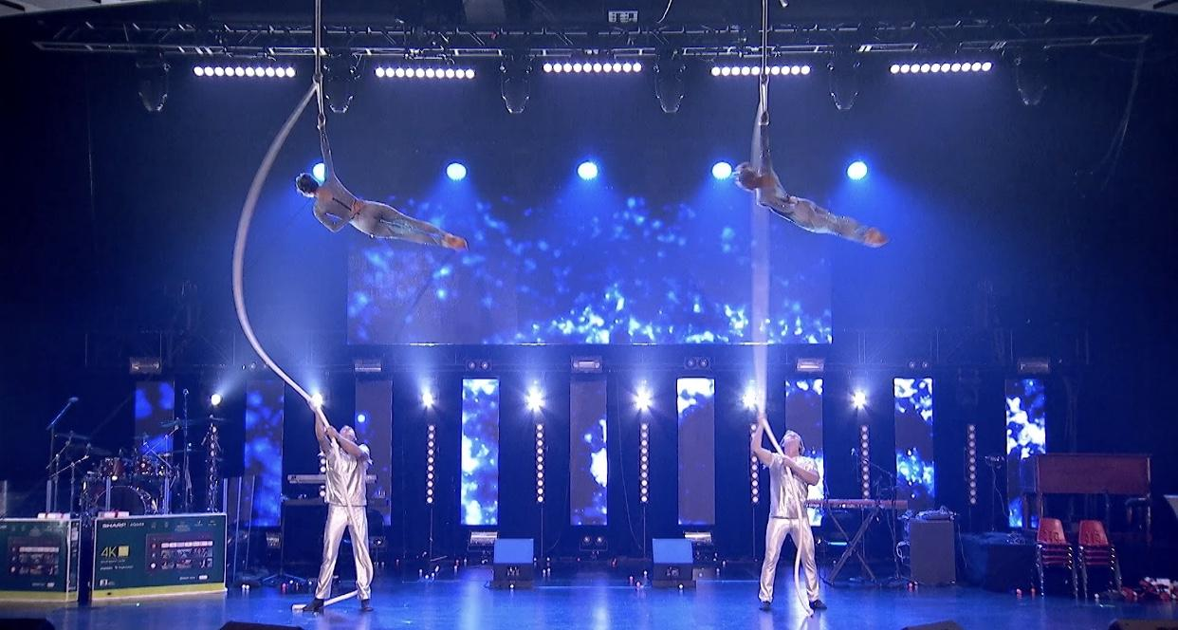
Spanish Webs Package
Price $3,500 each
Requirements
Minimum 19 ft ceiling clearance
18ft by 18ft square of level floor space
Rigging at venue on site or trussing rigging rigging cost not included in price. Please ask for rigging cost.
Package Includes
1 Aerial performer
1 Assistant Web Setter
Choreographed stage act or 3 5-min ambiance sets with 15 minute breaks between sets
Costumes
Liability Insurance day of event up to 1 mill
In venue rigging available at additional cost must do a walkthrough of the venue to do an assessment of the possible rigging locations.

Slide 2
Spanish Webs Video

Slide 3
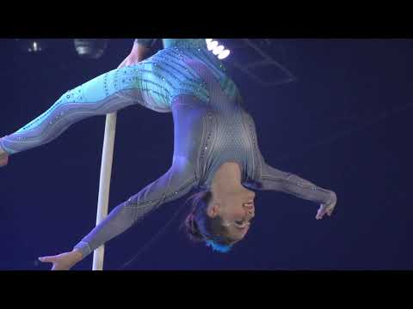
Spanish Webs Video

Slide 4
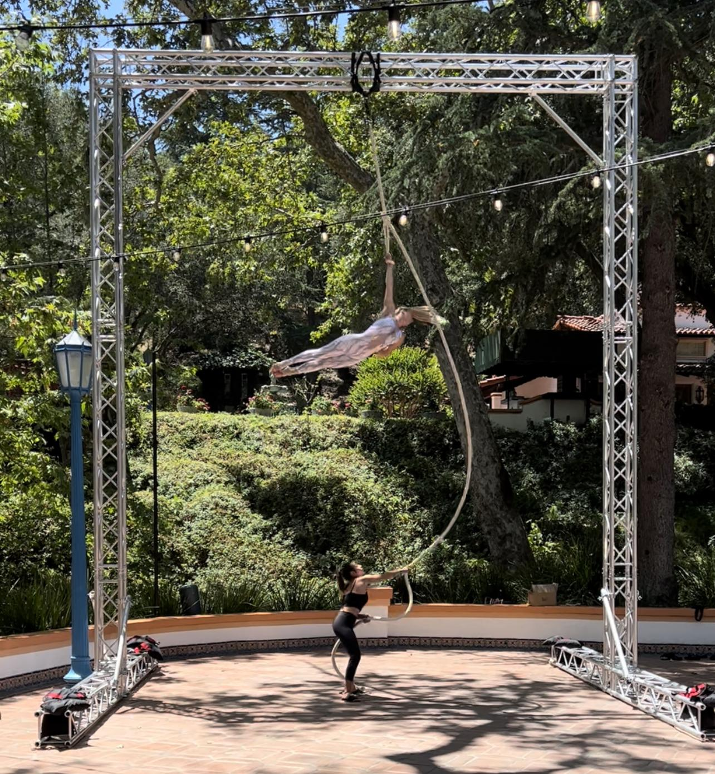
Spanish Webs Package
Including Portable Rigging
Price $6,250 and up
Requirements
Minimum 23ft ceiling clearance
20ft by 20ft square of level floor space
Package Includes
1 Aerial performer
1 Assistant Web Setter
Choreographed stage act or 3 5-min ambiance sets with 15 minute breaks between sets.
Costumes
Set up and tear down of Aerial Rigging
Liability Insurance day of event up to 1 mill
In venue rigging option available please ask for pricing must do a walkthrough of the venue to do an assessment of the possible rigging locations.

