Slide 1
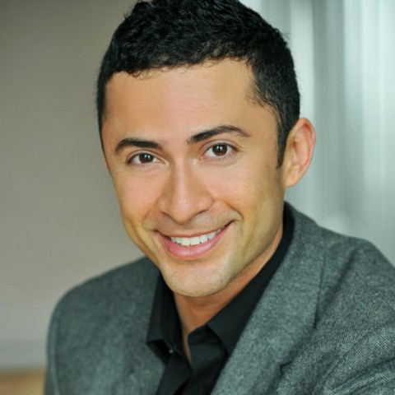
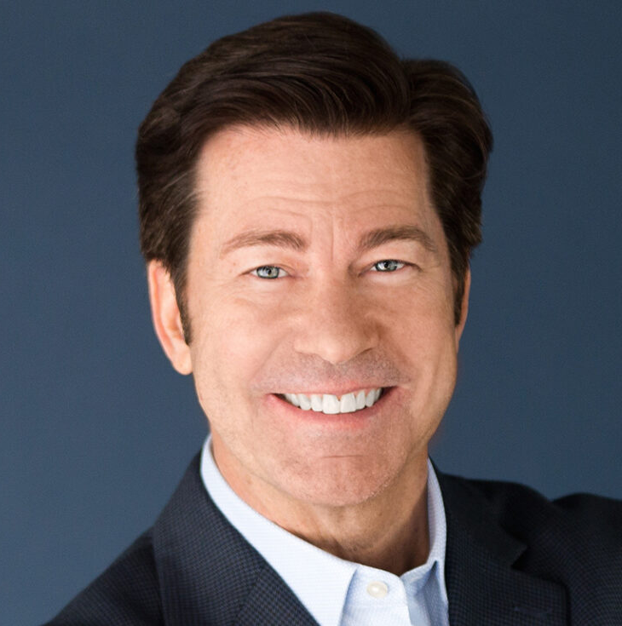
Watch Scott Bloom: Showcase Videos
Veteran comedian, television personality and highly-respected professional emcee and keynote speaker
Built a reputation as the go-to choice for business humor having hosted hundreds of events over two decades for companies such as FedEx, Ford, IBM, MetLife, PepsiCo, Pfizer and Verizon
Has been featured on Comedy Central, has hosted his own weekly VH1 series as well as national simulcasts for the Grammy Awards from the Palace Theatre
Described as smart, funny, clean and always engaging, never missing a beat, offering an authentic and relatable presence
Praised for his adaptability, turning unexpected moments into corporate gold, creates atmospheres of connection with an uncanny ability to deliver messages that are always embraced and leave audiences inspired
KEYNOTE TOPIC:
It’s A Funny Thing
SCOTT BLOOM
Fee: $15,000
Client is responsible for a $1,500 travel buyout and hotel accommodations for up to (2) nights
** Travels from Los Angeles, CA

