Slide 1
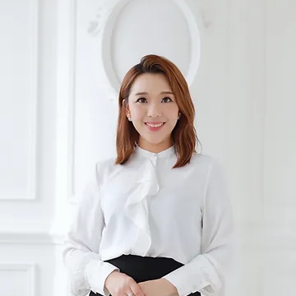
Watch Patrizia: Book Fair Hong Kong
Watch Patrizia: Dell Technologies Forum
Patrizia is an award-winning trilingual emcee, a corporate trainer specialises in communications and international etiquette, as well as an entrepreneur. ​
Born and raised in the dynamic international city of Hong Kong, Patrizia is a global citizen who has an international mindset extensively exposed to other cultures
Patrizia Yeung speaks five languages, has lived and travelled to over 25 countries. She was educated under the British education system while deeply influenced by traditional Chinese values in the family.
Patrizia was elected President of a local female chapter under international youth leadership platform, a non-profit organisation, JCI Hong Kong Jayceettes (香港女青年商會).
Patrizia is a Certified International Business Etiquette Trainer from IEPAL in London, UK, an exclusive traditional finishing school trusted by European Aristocracy and Royal families from around the world.
Patrizia holds a Masters degree in Translation from The Chinese University of Hong Kong. She also studied in California, the United States.
Event Emcee Themes:
General Emcee
Business Emcee
Virtual Emcee
Patrizia Yeung
Event Emcee
Fee Pending
*Client is responsible for air travel, transfers and accommodation
** Patrizia travels from Hong Kong

