Slide 1
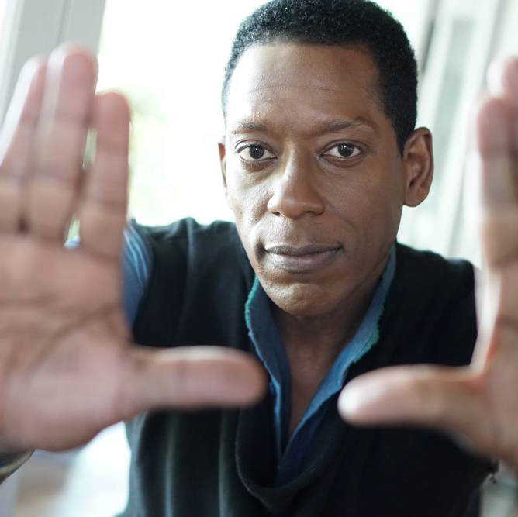
A Masterful Storyteller and Thought Leader in Media, Fandom, and Innovation redefining the future of entertainment and technology.
Orlando Jones is an award-winning actor, comedian, writer, and producer, celebrated for his versatile talent and expertise in technology.
A seasoned speaker, Jones has captivated audiences at events like the Congressional Black Caucus, Summit Mountain Series, and academic institutions, including USC’s Annenberg School, MIT, UCLA, and the University of Minnesota.
What sets Orlando apart is not just his mastery over multiple facets of the entertainment industry, but also his nuanced understanding of audience engagement and social narratives.
Keynote Topics:
OUTTHINK THE COMPETITION
CONQUERING INNOVATION AND CREATIVITY KILLERS
INNOVATING BEYOND THE R&D LAB
ORLANDO JONES
Celebrity Actor, Comedian & Speaker
Fee Pending
— Travel consists of:
+ RT First class airfare for Orlando (and possibly one assistant)
+ RT Ground Transportation in city of origin and Event city (Black SUV).
— Accommodations consist of:
+ Two nights’ hotel accommodations (room + tax and meals)
— 5-Star
— King suite
— reservation made by the client and billed directly to Client’s master account

