Slide 1
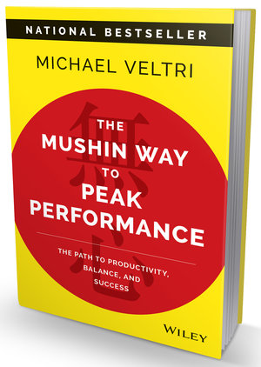
Watch Michael Veltri: Decision Making Challenges Busy Prefessionals Face
Watch Michael Veltri: How to Avoid the Fice Decision Making Traps
Entrepreneur who was founder and CEO of three successful startup businesses, leading to his experiences with leadership lessons
Author of the national bestseller The Mushin Way to Peak Performance: The Path to Productivity, Balance and Success
Recognizing that our successes both organizationally and personally are the culmination of our daily decisions, he elevates organizations, fuel-injects leadership and improves lives through better decision making practices
Decorated Marine Corps veteran and master-instructor in Japanese martial arts, discipline and leadership skills tht he brings to motivate, inspire and illustrate for audiences
Sample Takeaways:
Shares insights and research from wide-ranging resources from ancient Japanese warriors to brain science, from business titans to academic research to develop a groundbreaking model for better decision making that leads to unprecedented leadership and pear performance with balance and not burnout
Keynote Topics:
Decision-Making Mastery: How To Deliver Stunning Bottom-Line Results
Slaying the Sales Dragon: How to Crush the Top Line With Unprecedented Decision-Making Prowess
The 5 Decision-Making Secrets: Surprising, Unorthodox Approaches to Powerful Leadership Outcomes
MICHAEL VELTRI
Leadership & Transformation Expert
$21,000
*Client is responsible for round-trip airfare, ground transportation in event city, hotel accommodations and incidentals for up to two nights

