Slide 1
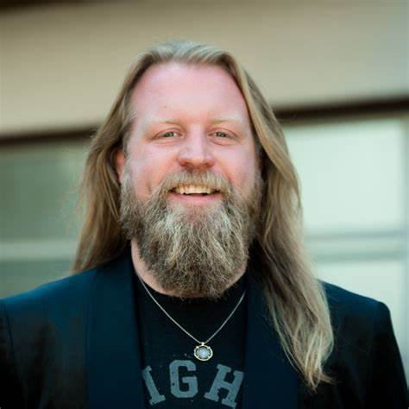
Watch Justin Wren: Speaker Reel
Mercilessly bullied as a child, Justin responded by transforming himself into a champion MMA fighter. Despite his success, he slid into pain-killer addiction, battled depression and attempted suicide.
A chance encounter leading him to live among the Pygmy people led him to his true purpose of helping others and back to the ring with a greater mission in life.
10-time wrestling State Champion, 5-time All American, and 2-time National Champion wrestler, UFC veteran, and has been inducted into the Black Belt Magazine Hall of Fame
Lived in one of the most remote rainforests on earth among the Pygmy people, some of the most impoverished and marginalized people on the planet which is where he found his true purpose of helping people
Founder of Fight For The Forgotten, a non-profit which has provided more than 52,000 indigenous people with access to clean drinking water, replanted thousands of trees, acquired more than 3,000 acres of land in the name of the tribe and helped 1,800 people out of slavery and into freedom since its foundation in 2012
Key Takeaways:
Shares his story from humble beginnings to MMA stardom, losing it all to drugs and depression, teaching audience's personal techniques to confront any adversity with the goal of maximizing impact
Keynote Topics
PURPOSE – PERFORMANCE – IMPACT
TAPPING INTO A FIGHTER’S MIND
THE NEW WAVE OF CHARITY, SUSTAINABILITY, AND OPPORTUNITY
SERVANT LEADERSHIP, CHARACTER DEVELOPMENT, AND DIFFERENCE MAKING
FACE IT ALL, FEEL IT ALL, AND MAGIC HAPPENS
Justin Wren
MMA Legend | Motivational Speaker
Fee: $20,000
*Client is responsible for first class, round-trip airfare, ground transportation, hotel accommodations and incidentals for two people for up to two nights

